Slide 1


Slide 2

PLANNING COMMISSION
WIRELESS ORDINANCE FOR INSTALLATIONS IN THE RIGHT-OF-WAY (ROW) JUNE 27, 2017
Christy Marie Lopez

Slide 3
INTRODUCTION
City’s Role
Federal Telecommunications Act
Preemption of local zoning authority
Significant Gap Analysis
Standards for Denial
ROW Management and CPUC
City’s Wireless Ordinance

Slide 4
CITY’S ROLE
Zoning = Regulation of Private Property
ROW Management = Coordinating Use of Public Property
Time, Place, and Manner
City as Owner/Landlord

Slide 5
FEDERAL TELECOM ACT
The Federal Telecommunications Act of 1996
Purpose “to provide for a pro-competitive, de-regulatory national policy framework designed to accelerate rapidly private sector deployment of advanced information technologies and services to all Americans by opening all telecommunications markets to competition....”
(H.R. REP. NO. 104-458 (1996)).

Slide 6
FEDERAL TELECOM ACT
Section 253(a) of the Telecommunications Act
No State or local statute or regulation, or other State or local legal requirement, may prohibit or have the effect of prohibiting the ability of any entity to provide any interstate or intrastate telecommunications service.” (47 U.S.C. § 253(a).)

Slide 7
FEDERAL TELECOM ACT
Section 332(c)(7)(A) of the Telecommunications Act
“[N]othing in this [Act] shall limit or affect the authority of a State or local government or instrumentality thereof over decisions regarding the placement, construction, and modification of personal wireless service facilities.” (47 U.S.C. § 332(c)(7)(A).)

Slide 8
FEDERAL TELECOM ACT
Decisions on permit applications may not “unreasonably discriminate among providers of functionally equivalent services.” 47 U.S.C. § 332(c)(7)(B)(i)(I).
Zoning rules and permit approvals cannot discriminate between similar technologies or similarly situated service providers.
“[D]iscrimination based on traditional bases of zoning regulation such as preserving the character of the neighborhood and avoiding aesthetic blight are reasonable and thus permissible.” MetroPCS v. City and County of San Francisco, 400 F.3d 715, 727 (9th Cir. 2005).

Slide 9
FEDERAL PREEMPTION OF LOCAL ZONING CONTROL
Zoning regulations must not “prohibit or have the effect of prohibiting the provisions of personal wireless services.”
47 U.S.C. § 332(c)(7)(B)(i).
This means a City cannot ban wireless services.
Cannot have the actual effect of banning wireless services.
Cannot prevent a service provider from closing a significant gap in its service coverage.

Slide 10
SIGNIFICANT GAP ANALYSIS
Gap is a hole in the provider’s geographic service area
Service Provider bears the burden of proving:
Existence of the gap
The project closes the gap in the least intrusive means possible.
Gap v. Capacity

Slide 11
STANDARDS FOR DENIAL
Denials can be based on aesthetics / least intrusive means.
Denials of applications cannot be based on “the environmental effects of radio frequency emissions to the extent that such facilities comply with the [FCC’s] regulations concerning such emissions.” 47 U.S.C. § 332(c)(7)(B)(iv).

Slide 12
STANDARDS FOR DENIAL
Denial of a wireless facility permit must be supported by substantial evidence in the written record of the hearing. See 47 U.S.C. § 332(c)(7)(B)(iii); MetroPCS, 400 F.3d at 723-24.
Substantial evidence = “less than a preponderance, but more than a scintilla of evidence. It means such relevant evidence as a reasonable mind might accept as adequate to support a conclusion.”

Slide 13
FEDERAL SHOT CLOCKS
A city must act “within a reasonable period of time” when reviewing an application for a wireless telecommunications facility.
FCC decision now imposes time limits on the processing of applications for wireless telecommunication facilities.
60 days for collocations or modifications not resulting in a substantial change
90 days for all other collocation or modications.
150 days for new facilties.

Slide 14
ROW MANAGEMENT
California Public Utilities Code § 7901
“[T]elephone corporations may construct … telephone lines along and upon any public road or highway, … and may erect poles, posts, piers, or abutments for supporting the insulators, wires, and other necessary fixtures of their lines, in such manner and at such points as not to incommode the public use of the road or highway….”

Slide 15
ROW MANAGEMENT
California Public Utilities Code § 7901.1
“(a) It is the intent of the Legislature, consistent with Section 7901, that municipalities shall have the right to exercise reasonable control as to the time, place, and manner in which roads, highways, and waterways are accessed.
“(b)The control, to be reasonable, shall, at a minimum, be applied to all entities in an equivalent manner.
…”

Slide 16
ROW MANAGEMENT
§ 7901.1: Time, Place, and Manner
No unreasonable interference with public’s use of ROW.
Discretionary permitting allowed.
Insurance, bonding, and indemnity requirements.
Compliance with building codes.
Aesthetic regulations allowed. Sprint PCS Assets v. City of Palos Verdes Estates, 583 F.3d 716, 725 (9th Cir. 2009)

Slide 17
SB 649
Passed on Senate Floor with 32 -1 vote
Legislation pending in the Assembly
Hearing tomorrow in Local Govt Committee
Strips local authority of any discretionary approval; only ministerial permits allowed
Allows for equipment up to 21 cubic feet

Slide 18
CASE LAW
American Tower Corporation v. City of San Diego
(763 F.3d 1035)
American Tower Corp (ATC)’s 3 CUPs expired after 10 years
ATC did not provide siting or design solutions and refused to consider modifications
SDMC required that the towers be “minimally invasive”
City’s denial was supported by substantial evidence

Slide 19
CASE LAW
American Tower Corporation v. City of San Diego
(763 F.3d 1035)
Court did not find “effective prohibition” of wireless service
2 prong analysis: 1) significant gap 2) alternatives or least intrusive means
ATC failed to show least intrusive means , did not offer feasibility analysis, offer alternate location or designs

Slide 20
T-Mobile v. San Francisco
Appellate court affirmed local entities right to regulate aesthetics
Supreme Court review pending

Slide 21
CITY’S ORDINANCE
City’s Need for Updated Regulations
140 wireless installations currently in the ROW
Federal shot clocks require approval/denial within a limited period of time

Slide 22
PROPOSED ORDINANCE
Application
New application and process implemented
Tiered Permitting
Major Wireless Telecommunications Facility Permit
Administrative Wireless Telecom Facility Permit
Master Deployment Plan Permit
Notice Requirements
Community notice for mock-ups
Public hearing notice
Notice to City prior to shot clock expiration

Slide 23
NEW SUBMITTAL REQUIREMENTS
Required to be submitted for evaluation:
Detailed Plans
Alternative Site Analysis
Visual Impact Analysis including Photo Sims
Propagation Maps
Deposit for Independent Expert Review
RF Compliance Report

Slide 24
NEW PROCESS
Process for proposed installations
Submittal of Wireless Telecom application
(Recommended) Pre-submittal conference
Application submittal appointment
Mock-ups
Public hearing
Planning Commission hearing for all MWTFP and MDPP
All appeals subject to a public hearing

Slide 25
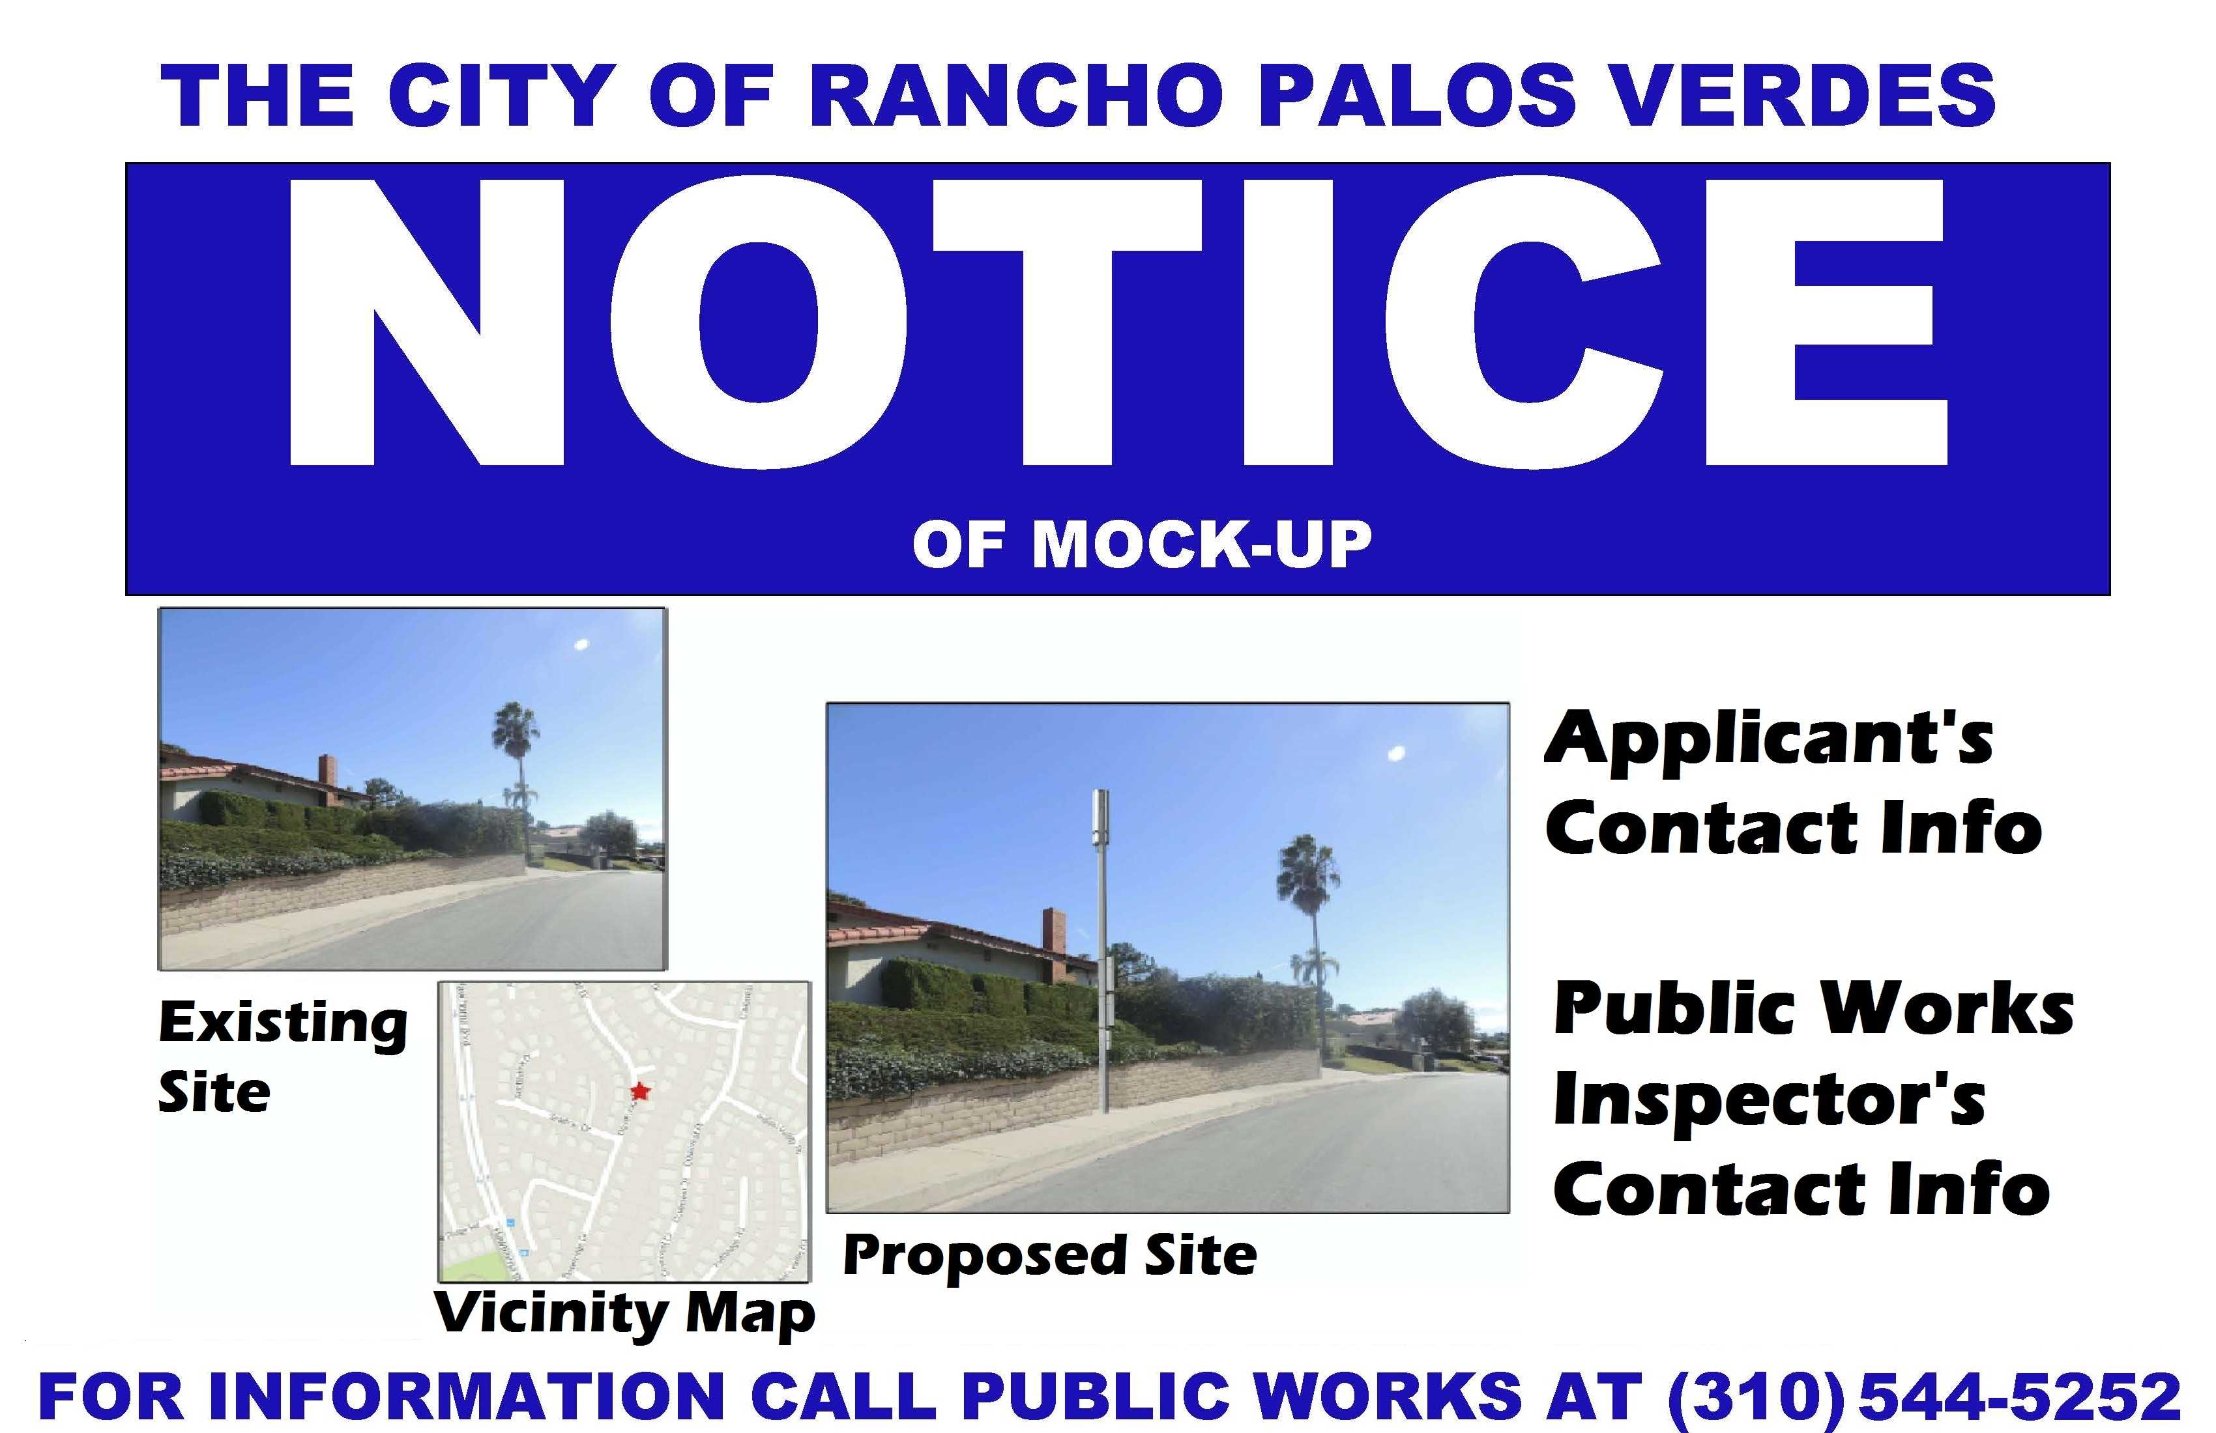

Slide 26
PROVISIONS TO PROTECT AESTHETICS AND PROPERTY VALUES
Community Impact Standards:
Screening or camouflage
Landscaping if appropriate
Noise limits
Lighting limits
New poles discouraged
Undergrounding of equipment preferred where feasible
Preferred locations encouraged:
Non-local streets
Collocations

Slide 27
TRANSPARENCY AND INFORMATION
Additional noticing requirements
Cell Site Webpage: http://www.rpvca.gov/916/Cell-Sites
Information: Trifold and FAQs

Slide 28
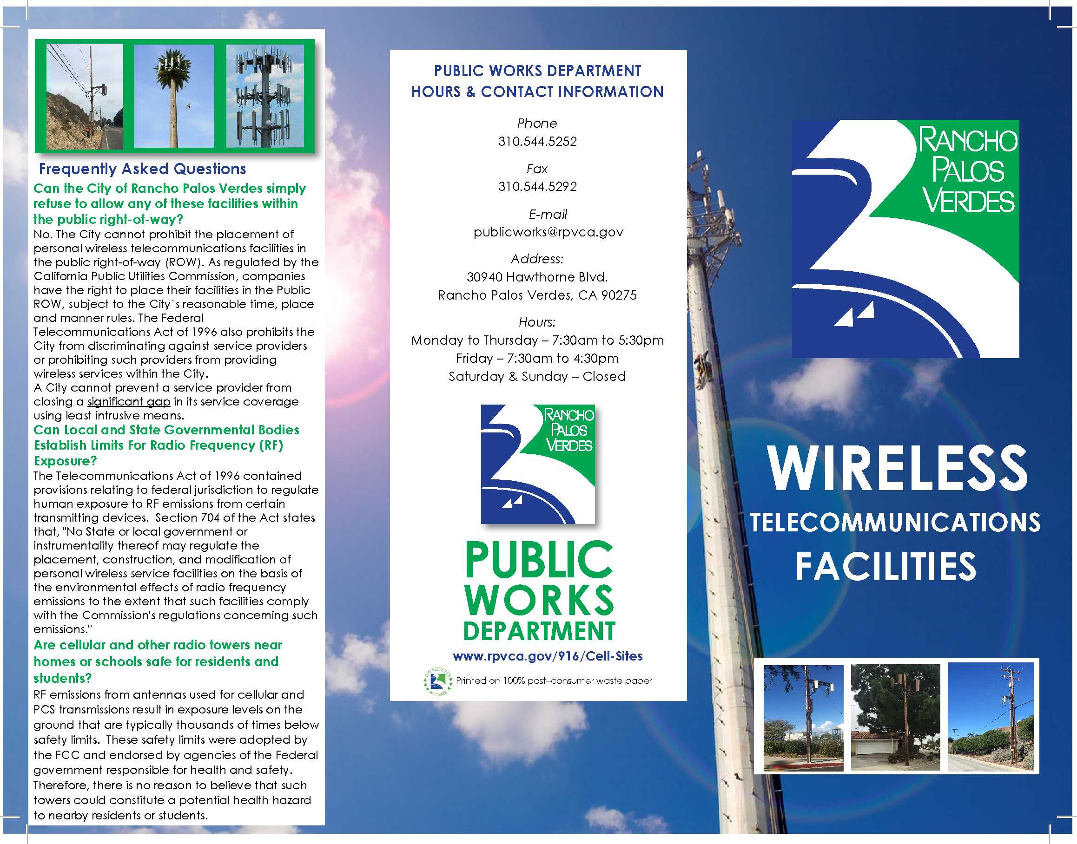

Slide 29
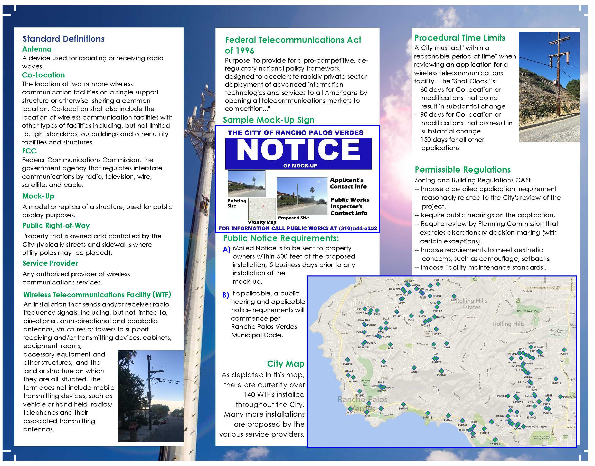

Slide 30
Granting Permit - Findings
No permit shall be granted for a wireless telecommunications facility unless all of the following findings are made by the director:
A. All notices required for the proposed installation have been given.
B. The proposed facility has been designed and located in compliance with all applicable provisions of this chapter.
C. If applicable, the applicant has demonstrated its inability to locate on existing infrastructure.
D. The applicant has provided sufficient evidence supporting the applicant's claim that it has the right to enter the public right-of-way pursuant to state or federal law, or the applicant has entered into a franchise agreement with the city permitting them to use the public right-of-way.
E. The applicant has demonstrated the proposed installation is designed such that the proposed installation represents the least intrusive means possible and supported by factual evidence and a meaningful comparative analysis to show that all alternative locations and designs identified in the application review process were technically infeasible or not available.
(RPVMV § 12.18.090.)

Slide 31
Exception - Findings
The planning commission shall not grant any exception unless the applicant demonstrates with clear and convincing evidence all the following:
1. The proposed wireless facility qualifies as a "personal wireless services facility" as defined in United States Code, Title 47, section 332(c)(7)(C)(ii);
2. The applicant has provided the city with a clearly defined technical service objective and a clearly defined potential site search area;
3. The applicant has provided the city with a meaningful comparative analysis that includes the factual reasons why any alternative location(s) or design(s) suggested by the city or otherwise identified in the administrative record, including but not limited to potential alternatives identified at any public meeting or hearing, are not technically feasible or potentially available; and
4. The applicant has provided the city with a meaningful comparative analysis that includes the factual reasons why the proposed location and design deviates is the least noncompliant location and design necessary to reasonably achieve the applicant's reasonable technical service objectives.
(RPVMC § 12.18.190(B).)

Slide 32
Thank you for attending.
Christy Marie Lopez
Of Counsel
Best Best & Krieger LLP
Irvine Office
Phone: 949-263-2600
Email: christy.lopez@bbklaw.com
www.bbklaw.com

