Slide 1
TRUMP NATIONAL GOLF CLUB
VESTING TRACT 50666
COSTA DE LA ISLAS
STREET DESIGN ALTERNATIVES
JULY 17, 2018 City Council meeting

Slide 2
Recommended Council Action
Review the alternative street design configurations, including the Traffic Safety Committee’s (TSC) recommendation and the Staff’s preferred street design alternative; and,
Identify the Council-preferred street design Alternative for the new intersection at Costa De La Islas and PVDS.

Slide 3
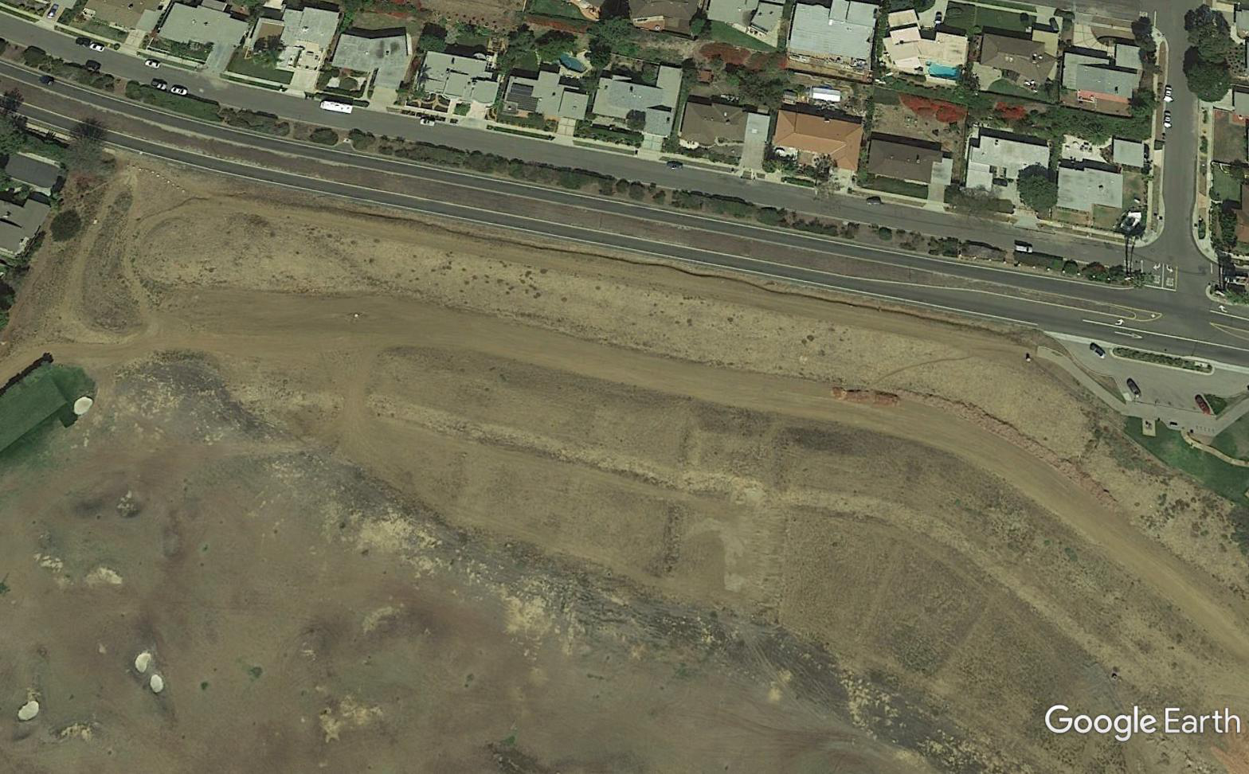
Project Site

Slide 4
Historic Background
On June 1, 1992, the City Council conditionally approved Vesting Tentative Tract Map Nos. 50666 and 50667 on a 261.4 acre site
  Residential Planned Development (RPD) to accommodate single-family dwelling units 18-hole public golf course.
  Infrastructure improvements (including public streets serving the project).
  Public Amenities including open space lots, trails, and public parking.
On April 15, 1993, the Coastal Commission approved the Project’s Coastal Development Permit.
In 1993, City Council and Wildlife Agencies approved the Project’s Habitat Conservation Plan (HCP).
On November 20 1997, City Council approved a Development Agreement to vest certain development rights between the City and the Developer.
On June 7, 2005, the City Council approved a revision to Vesting Tentative Tract Map No. 50666
  Driving Range
  Reduced the number of residential lots from 39 to 23
  12 residential lots located on Costa de la Islas with access off Palos Verdes Drive South

Slide 6
Vesting Maps
California Government Code Section 66498.9(b)
To ensure that local requirements governing the development of a proposed subdivision are established in accordance with Section 66498.1 when a local agency approves or conditionally approves a vesting tentative map. The private sector should be able to rely upon an approved vesting tentative map prior to expending resources and incurring liabilities without the risk of having the project frustrated by subsequent action by the approving local agency, provided the time periods established by this article have not elapsed.

Slide 7
Vesting Maps - Exception
Extraordinary circumstances creating a menace to public health and safety

Slide 8
Tentative vs. Final Maps
The primary difference between a tentative and a final map is that the latter is recorded and does not expire, and must comply with certain content and format requirements. (Gov. Code § 66433 et seq.)
Once a tentative map is approved, no additional conditions or substantive design changes can be required.
The nature of the vested rights is not affected by the tentative or final nature of the map.

Slide 10
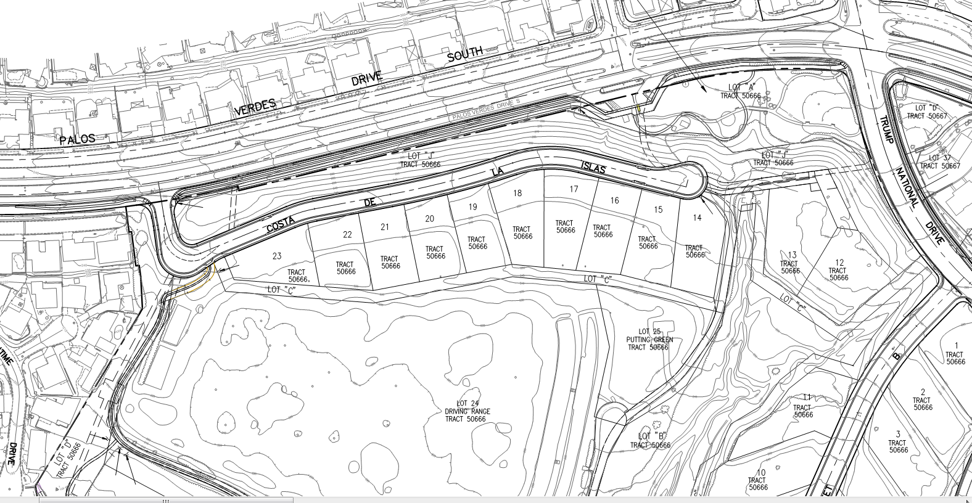

Slide 11
STREET DESIGN APPROVAL
The proposed on-site streets shall be dedicated for public use on the Final Map and designed to the satisfaction of the Director of Public Works. Prior to recordation of the Final Map, the Applicant shall submit design specifications for the on-site streets to the Director of Public Works for approval.

Slide 12
TRUMP NATIONAL TRACT 50666
Approval Process:
    Applicant submitted plans and updated Traffic Impact Analysis (TIA);
    The documents were submitted to the Traffic Safety Committee (TSC) for transparency purposes and to allow the public the opportunity to review and comment;
    TSC opened discussion regarding this item on August 28, 2017;
    The item was continued to extend the time for public comments through December 2017; and,
    On December 11, 2017, TSC made its recommendation.

Slide 14
Traffic Study Summary
  Updated Traffic Impact Analysis by Applicant, Dated October 24, 2017
      Trip Generation
      Trip Distribution
      Queuing Analysis
      Collision Summary
      Sight Distance Analysis
      Truck Turning Analysis

Slide 15
Alternative 1 – New T-Intersection with
All Movements Allowed
Advantages Disadvantages
•A left-turn lane allowing west-bound traffic along PVDS into the development;
•An exclusive right-turn lane allowing east-bound traffic along PVDS to move over and make a right-turn into development; and,
•An acceleration (merge) lane along the median which would allow a refuge space for vehicles exiting northbound out of the development right after crossing PVDS eastbound traffic and just before merging into PVDS (west bound) traffic.
Allows all turning movements into and out of Costa De La Islas;
Eliminates need for U-turns at Schooner Drive, Conqueror Drive, and Trump National Drive intersections at PVDS; and,
Makes provisions for large trucks.
  Introduces turning movement conflicts at Costa De La Islas; and,
  Reduces the width of the median.

Slide 16
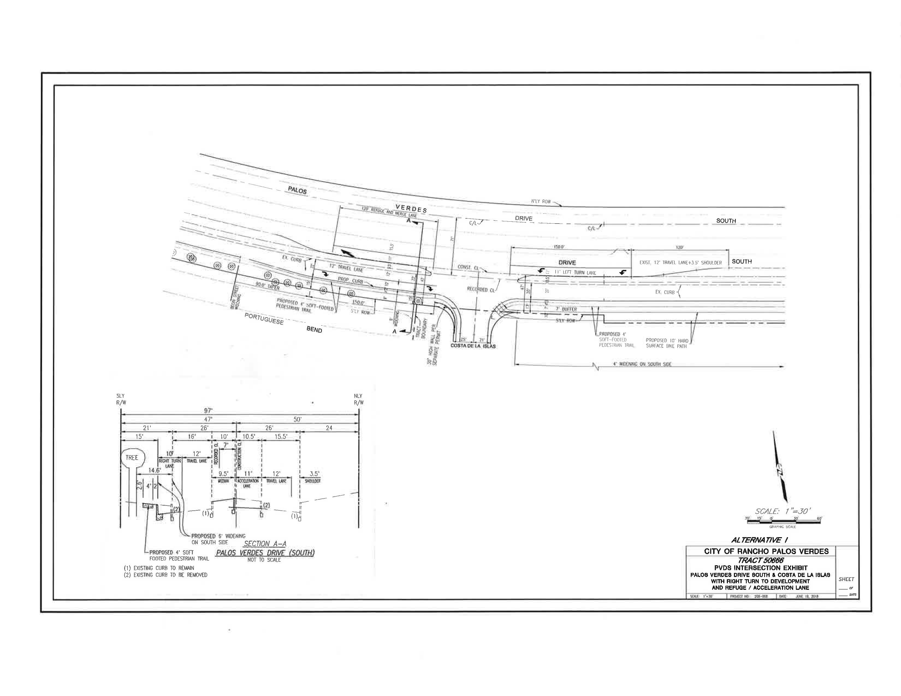

Slide 17
Alternative 2 – Right Turn In/Right Turn Out Access Only
•An exclusive right-turn lane allowing east-bound traffic along PVDS to move over into the exclusive right-turn lane and make a right turn into the development.
Advantages:
Disadvantages:
Reduces turning movement conflicts;
No median break;
No median width reduction; and,
Reduces potential for collisions at Costa De La Islas.
  Increases U-turns at Schooner Drive, Conqueror Drive, and Trump National Drive;
  Inconvenient for motorists existing Costa De La Islas wishing to go west;
  Inconvenient for westbound motorists who wish to access Costa De La Islas;
  Difficult U-turn maneuvers for large vehicles; and
  May increase emergency response times as compared to Alternative No. 1.

Slide 18
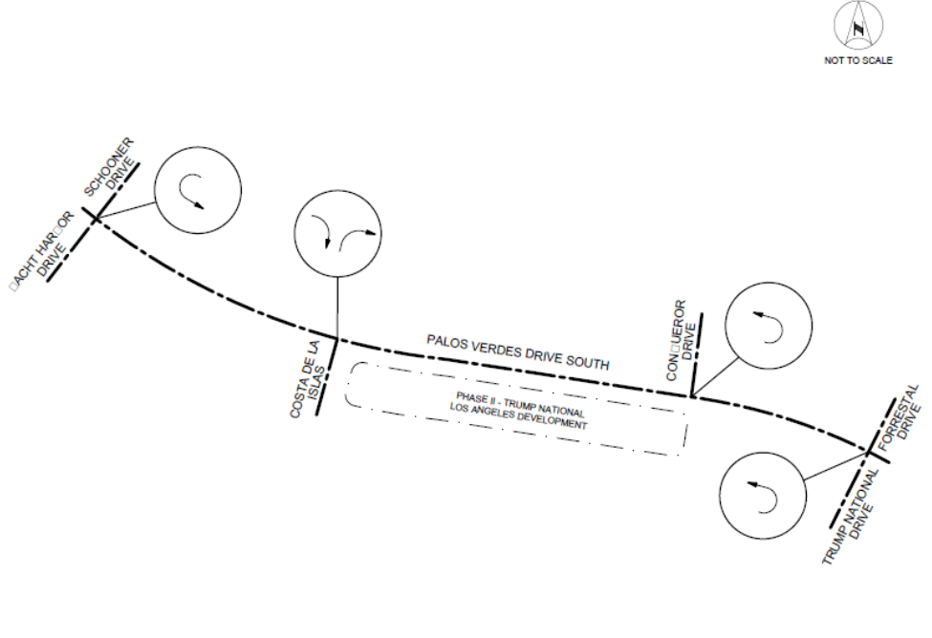
Alternative 2 - Layout

Slide 19
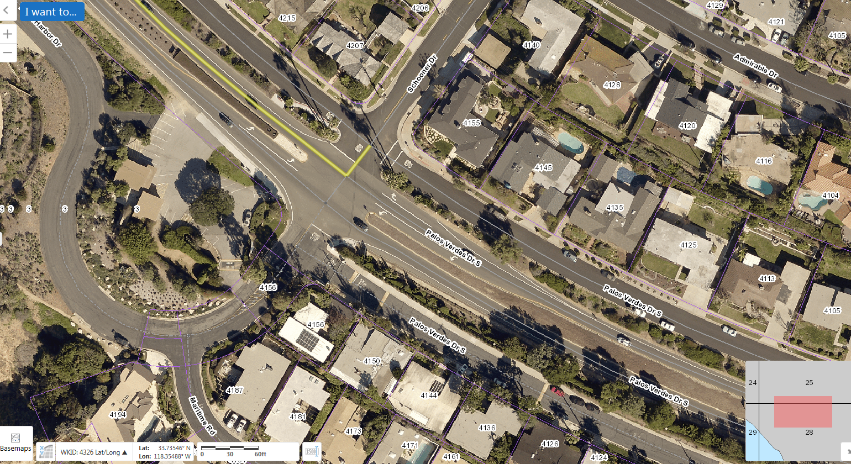
PVDS @ SCHOONER DR.

Slide 20
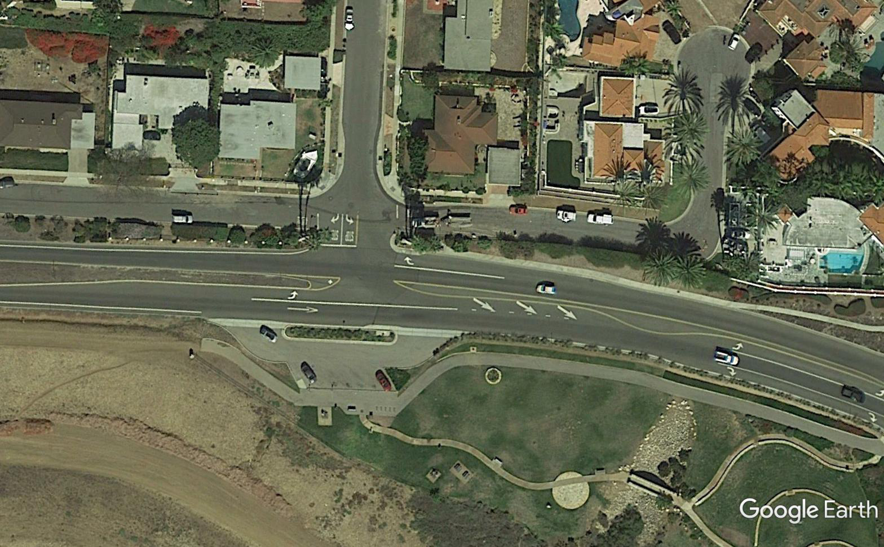
PVDS @ CONQUEROR DR.

Slide 21
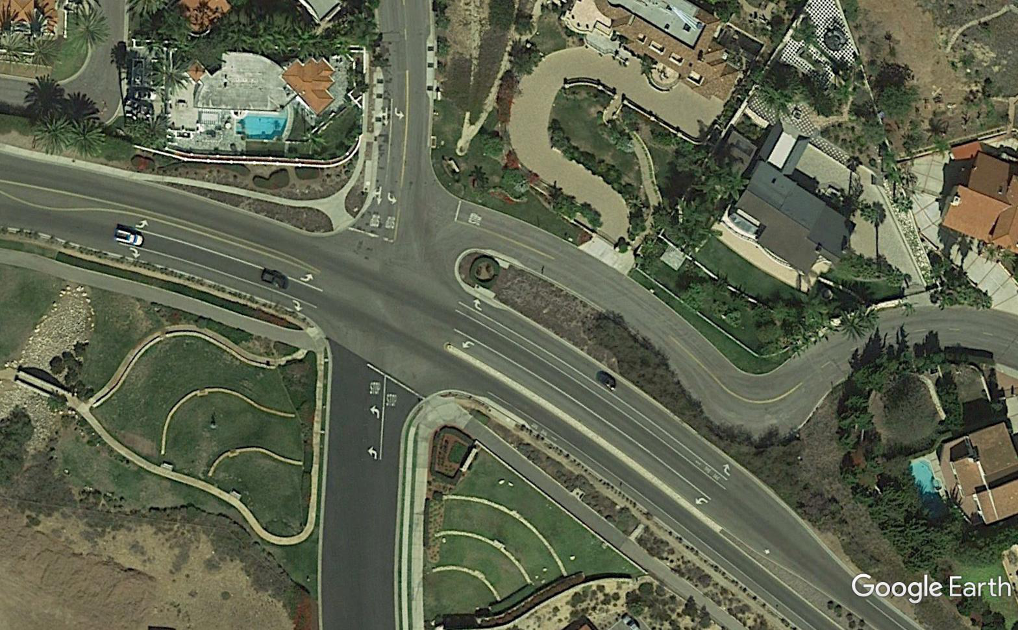
PVDS @ TRUMP NATIONAL/FORRESTAL DR.

Slide 22
Alternative 3 – Right Turn In/Right Turn Out
& Left-Turn In
•An exclusive right-turn lane allowing east-bound traffic along PVDS to move over into the exclusive right-turn lane and make a right turn into the development; and,
•A hooded left-turn lane along the median which would allow only a left-turn movement for west-bound traffic along PVDS into the development. Under this alternative, vehicular traffic leaving the development cannot make a left-turn into PVDS, westbound.
Advantages: Disadvantages:
Reduces turning movement conflicts;
No U-turns required at Schooner Drive;
No acceleration (merge) lane, thus less reduction in median width; and,
Improves emergency access as compared to Alternative No. 2.
  Increases U-turns at Conqueror Drive and Trump National Drive intersection;
  Inconvenient for motorists exiting Costa De La Islas wishing to go west;
  Difficult maneuvers for large vehicles; and,
  May increase emergency response times as compared to Alternative No. 1.

Slide 23
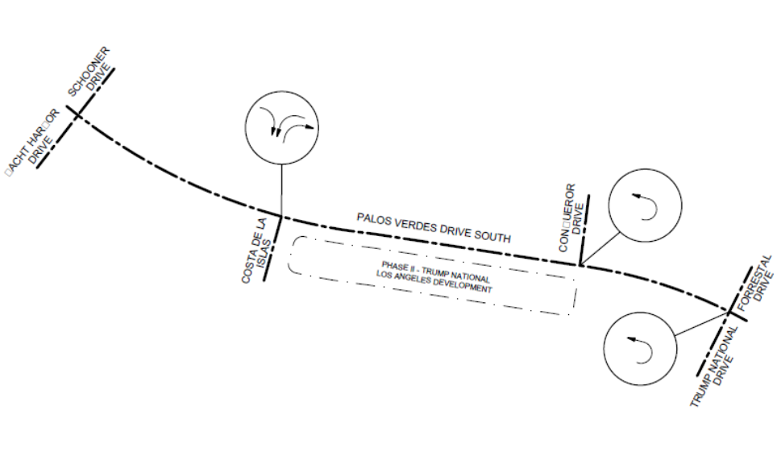
Alternative 3 - Layout

Slide 24
PVDS @ CONQUEROR DR.

Slide 25
PVDS @ TRUMP NATIONAL/FORRESTAL DR.

Slide 26
Alternative 4 – New T-Intersection with All Movements Allowed with the Exclusion of the Right Turn Lane
•A left-turn lane allowing west-bound traffic along PVDS into the development; and,
•An acceleration (merge) lane along the median for vehicles exiting the development and making a left turn into PVDS.
Advantages: Disadvantages:
Allows all turning movements into and out of Costa De La Islas;
Eliminates need for U-turns at Schooner Drive, Conqueror Dr., and Trump National Drive;
Makes provisions for large trucks;
Coastal trail width would not be reduced; and,
Existing homes would have better shielding from PVDS traffic.
  Introduces turning movement conflicts at Costa De La Islas;
  Reduces the width of the median; and,
  Vehicles wishing to make a right turn from Palos Verdes Drive South eastbound into the development will slow down the through traffic.
Note: This alternative is preferred by the Portuguese Bend Club HOA.

Slide 27
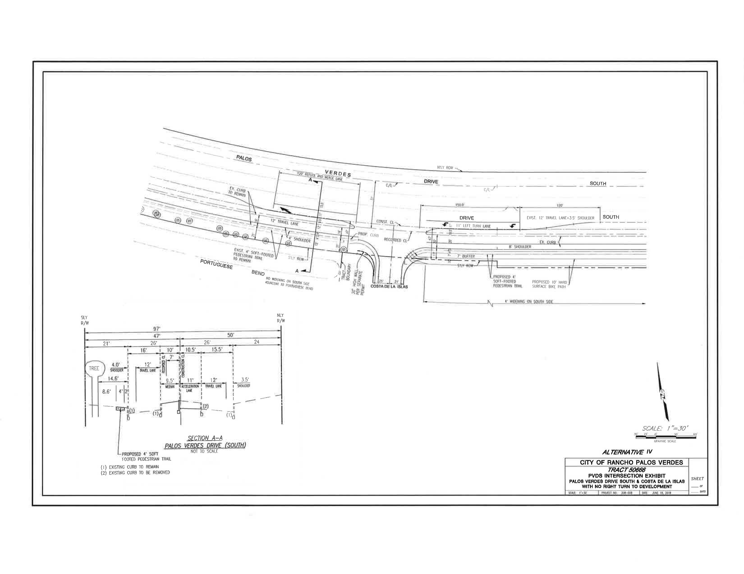

Slide 28
Alternative 5 - New T-Intersection with All Movements Allowed with the Exclusion of the of the Acceleration Lane
•A left-turn lane allowing west-bound traffic along PVDS into the development; and,
•An exclusive right-turn lane allowing east-bound traffic along PVDS to move over and make a right-turn into development.
lane onto Costa De La Islas
Advantages:
Disadvantages
Allows all turning movements into and out of Costa De La Islas;
Eliminates need for U-turns at Schooner Drive, Conqueror Drive, and Trump National Drive; and
Makes provisions for large trucks.
  Introduces turning movement conflicts at Costa De La Islas;
  Reduces the width of the median; and,
  Makes it difficult for vehicles exiting the development and wishing to make a left turn into PVDS to merge with through traffic since the acceleration (merge) lane is eliminated in this alternative.
Note: The applicant has not expressed opposition to any alternatives. However, the Applicant prefers this alternative.

Slide 29
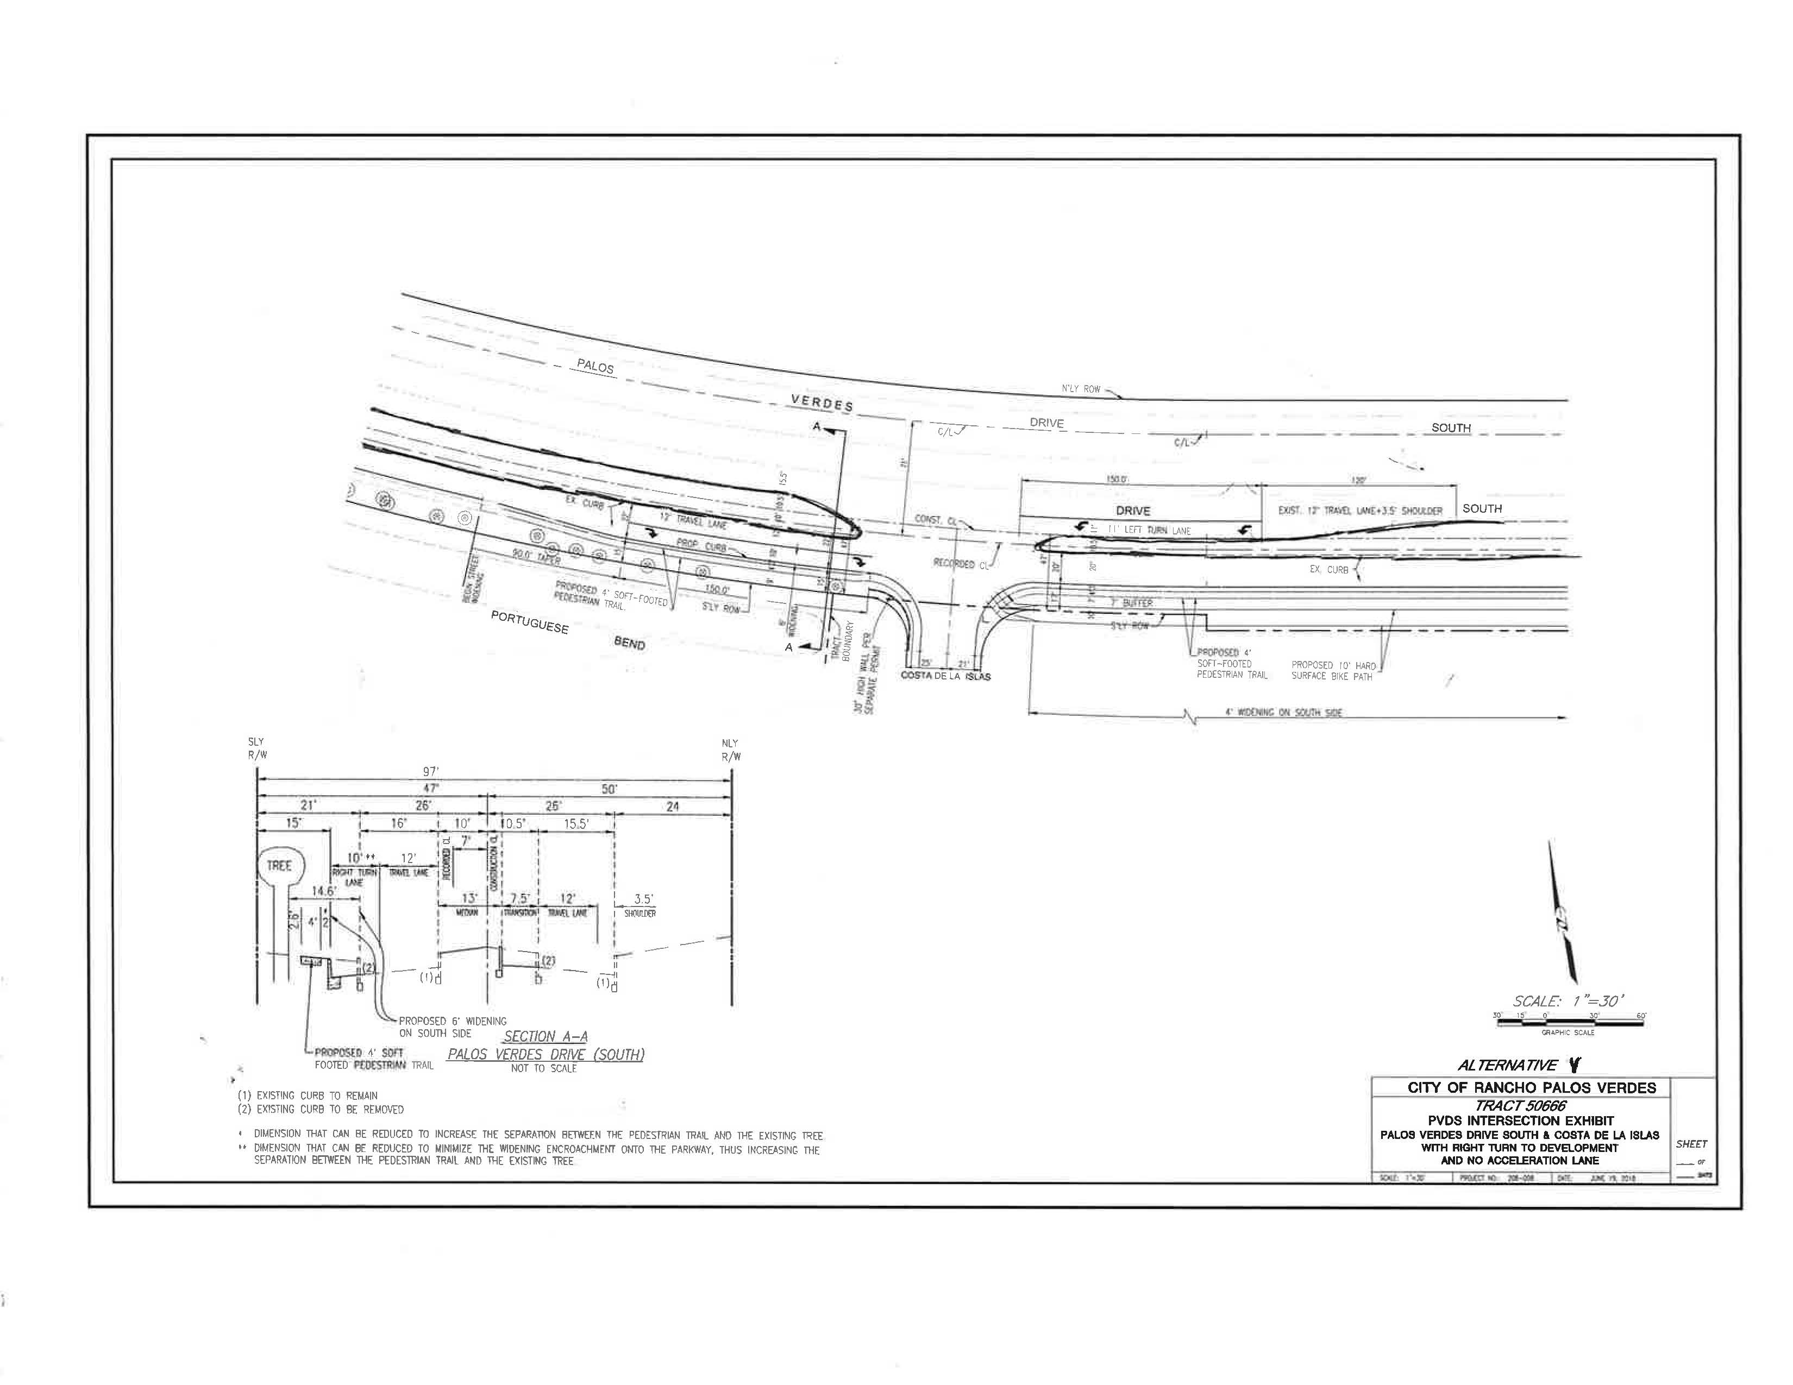

Slide 33
Alternative Ranking
Staff recommends the following ranking of the alternatives:
Median opening with an exclusive right turn lane, a left turn lane, and an acceleration (merge) lane as recommended by TSC (Alternative No. 1);
Median opening with a left turn lane, an acceleration lane, but no exclusive right turn lane, as requested by Portuguese Bend Club HOA (Alternative No. 4);
Median opening with a left turn lane, an exclusive right turn lane, but with no acceleration (merge) lane, as requested by the Applicant (Alternative No. 5);
An exclusive right turn lane only (Alternative 2, no median opening); and,
A hooded left turn lane along PVDS and an exclusive right turn lane along PVDS (Alternative No. 3).

Slide 34
PVDS @ CONQUEROR DR.

Slide 38
