Slide 1

David Kochen, Human Services Administrator II

Slide 2
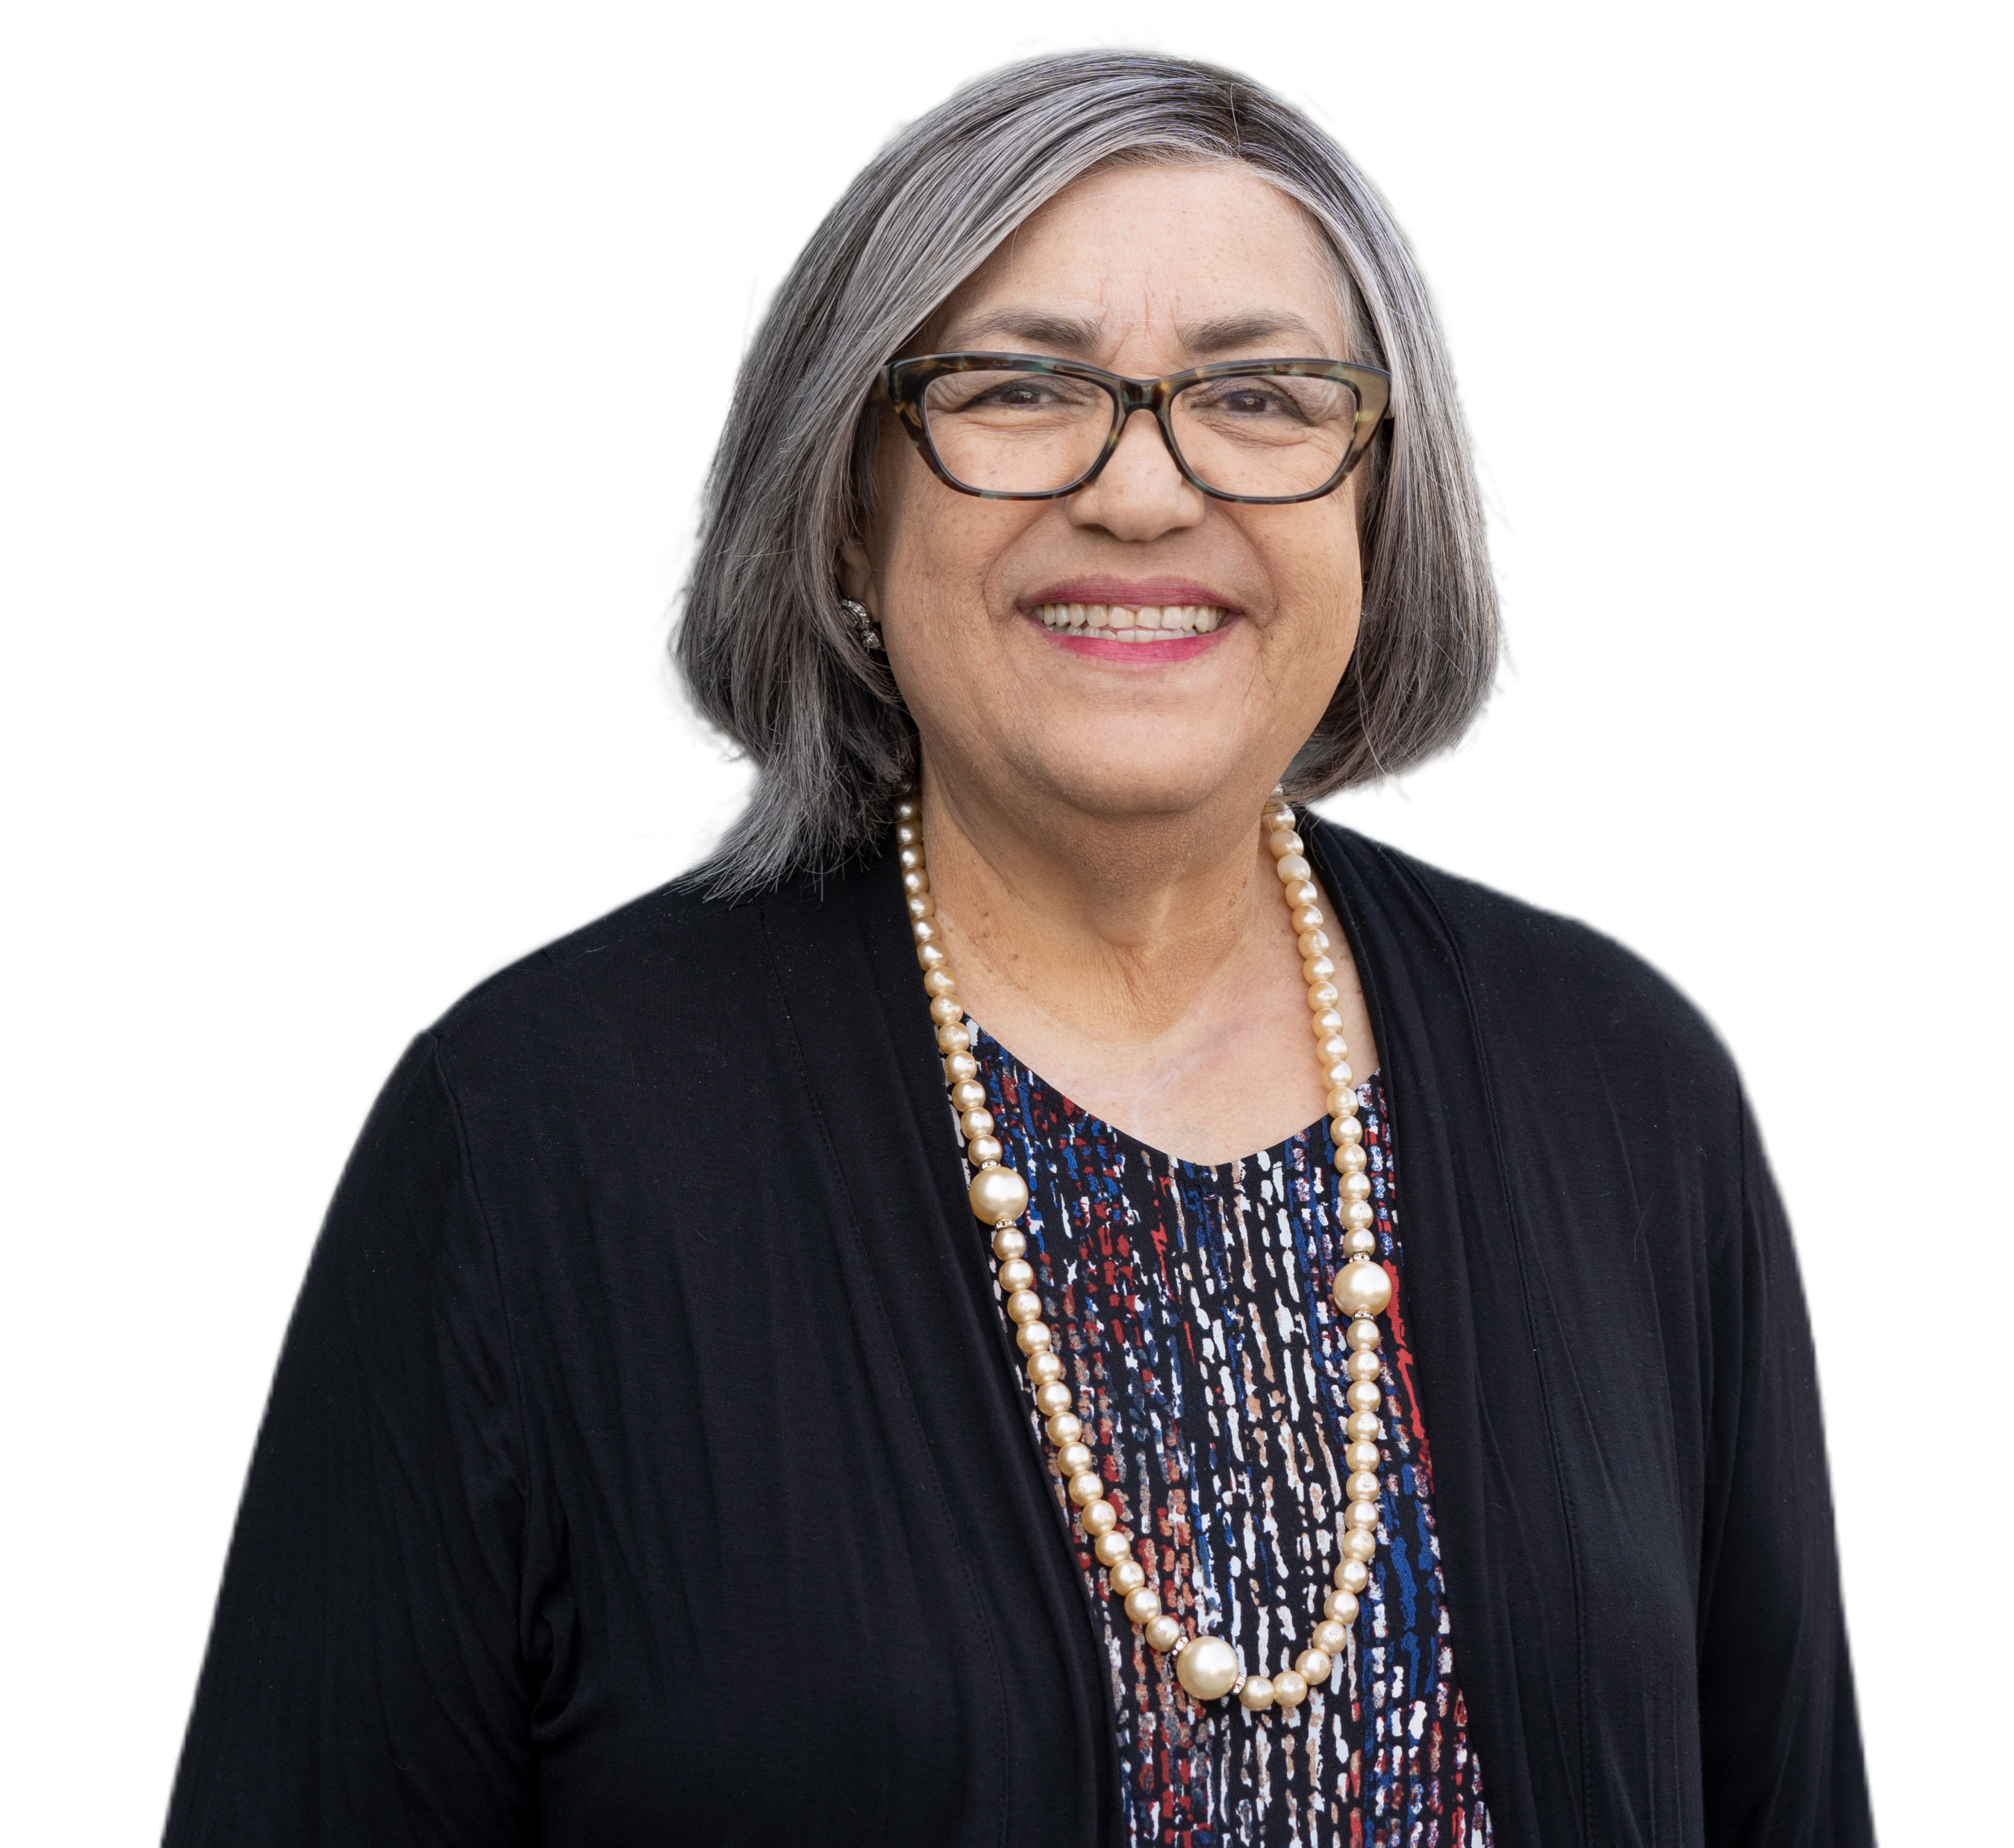
On July 1, 2022, the Board of Supervisors created a new County department dedicated to providing aging and disability services. The new Los Angeles County Aging & Disabilities Department (AD).
Dr. Laura Trejo, Director

Slide 3
Who We Are & What We Do

Slide 4

Who We Are & What We Do
  Our vision is
  “Living with dignity and independence”
  Our mission is to
  Improve lives and support self-determination for older adults, adults with disabilities, and communities
  Our commitment is to
  Help older, dependent, and disabled adults to age in place with dignity and independence
  Ensure the safety and well-being of older and dependent adults in their communities
  Create vibrant community centers that empower and connect residents

Slide 5
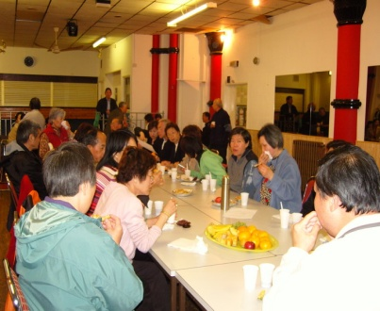
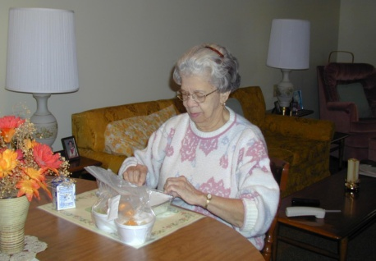




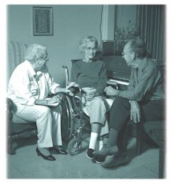



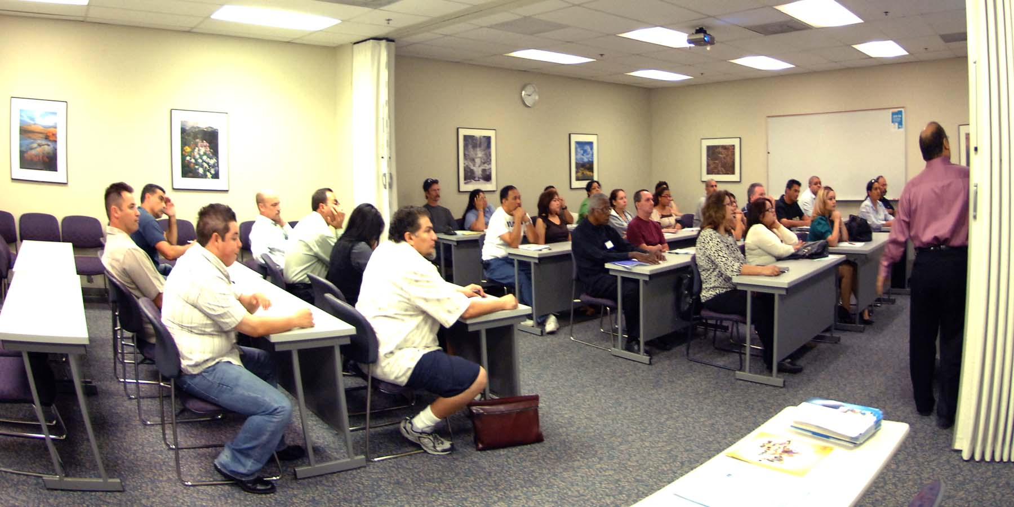
Area Agency on Aging
Congregate Meals
Home-Delivered Meals
Family Caregiver Support Program
CalFresh Healthy Living
Linkages Program
Health Insurance
Counseling & Advocacy
Long-Term Care Ombudsman
Senior Community Service Employment Program
Disease Prevention and Health Promotion
Legal Assistance
Supportive Services

Slide 6
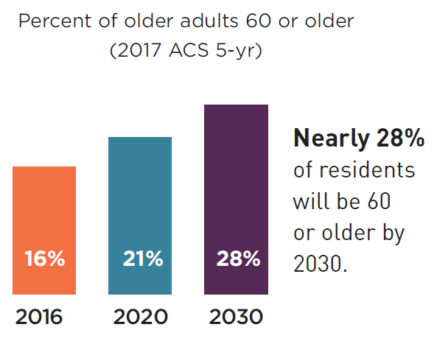
Purposeful Aging Los Angeles (PALA) purposefulagingla.com
The Los Angeles region’s older adult population is expected to nearly double to over 2 million by 2030.
PALA is an age-friendly initiative that seeks to prepare the Los Angeles region for a rapidly aging population through an innovative, sustained initiative that unites public and private leadership, resources, ideas and strategies that will improve the lives of older adults and Angelenos of all ages.

Slide 7










Aging & Disability Resource
Connection (ADRC)
LA County AAA, City of Los Angeles AAA, 211LA, Independent Living Centers (ILCs), and a community network of public, private, and non-profit agencies are collaborating to establish an LA County ADRC. This partnership forms No Wrong Door (NWD) Systems that assist individuals in navigating the complex system of long-term services and supports (LTSS). Core components are 1) enhanced information and referral services, 2) options counseling, 3) short-term service coordination, 4) transition services.
LA County Emerging ADRC Core Partners
2021 - 2022
2023 - 2024
2024 - 2025
Establish ADRC core partnership
Received ‘Emerging’ ADRC designation by CA Department of Aging (CDA).
Awarded $1.8 million in infrastructure grant funding.
Develop infrastructure and operations and launch LA County Emerging ADRC
Integrate LA City’s Central & South LA ADRC into LA County Emerging ADRC
Pursue ‘Designated’ ADRC status
*ADRCs are established in ‘Emerging’ status and become ‘Designated’ after meeting the California ADRC Designation Criteria.

Slide 8
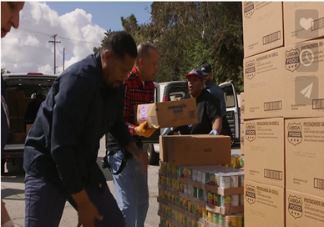

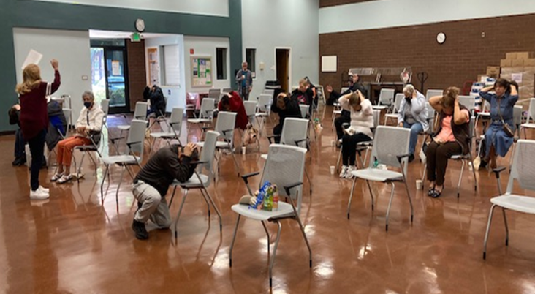

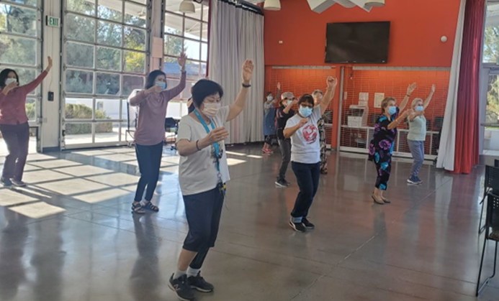
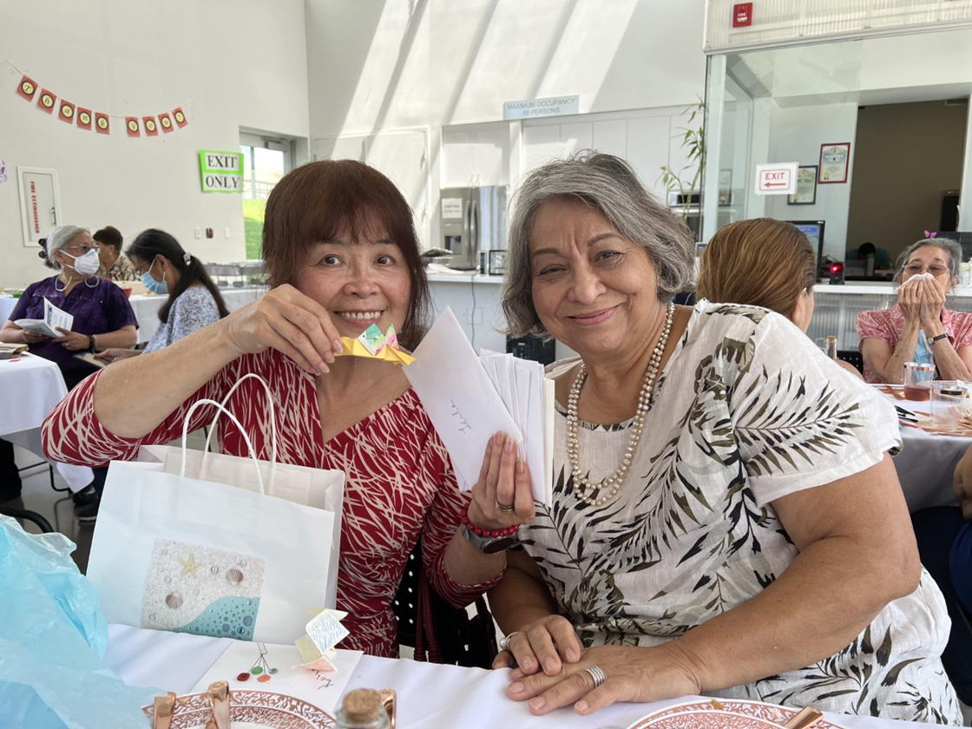
Community and Senior Centers
Aging & Disabilities Department operates 14 Community and Senior Centers in Los Angeles County that offer a wide range of services and social activities for the local communities and provide opportunities for daily learning, skills enhancement, community engagement, socialization, and healthy living for residents of all ages, such as:
Emergency Food Assistance Programs
Congregate Meals
Telephone Reassurance
Utility Assistance Program
Fitness and Exercise
Referral Services
Public Access Computers
Arts and Crafts
Seasonal Giveaways
Form Assistance
Educational Classes
Workshop

Slide 9
Adult Protective Services (APS)
Line Operations
APS investigates reports of abuse, neglect, and exploitation perpetrated against Elder and Dependent Adults
APS investigates approximately 4,500-5,500 reports every month

Slide 10
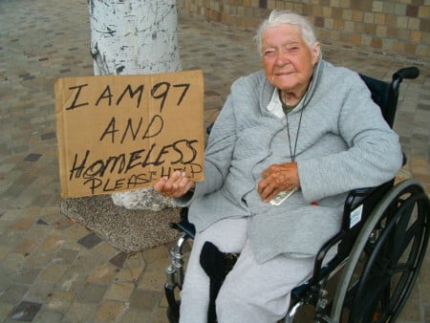

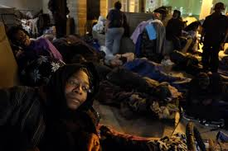
APS Home Safe Program
For people experiencing homelessness or are at risk of experiencing homelessness
The Home Safe program was established by the passage of Assembly Bill (AB) 1811 to support the safety and housing stability of Adult Protective Services (APS) clients by providing housing-related assistance for homelessness prevention.

Slide 11



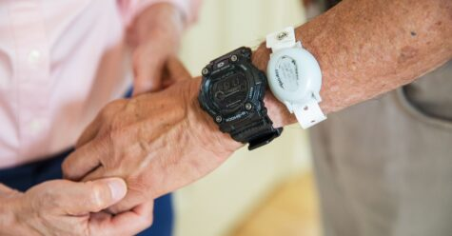

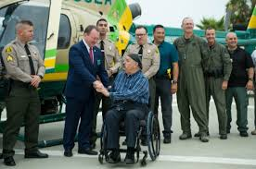
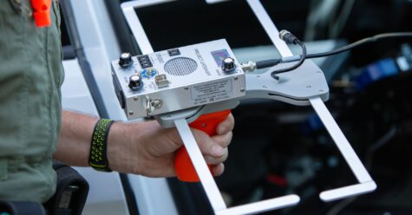
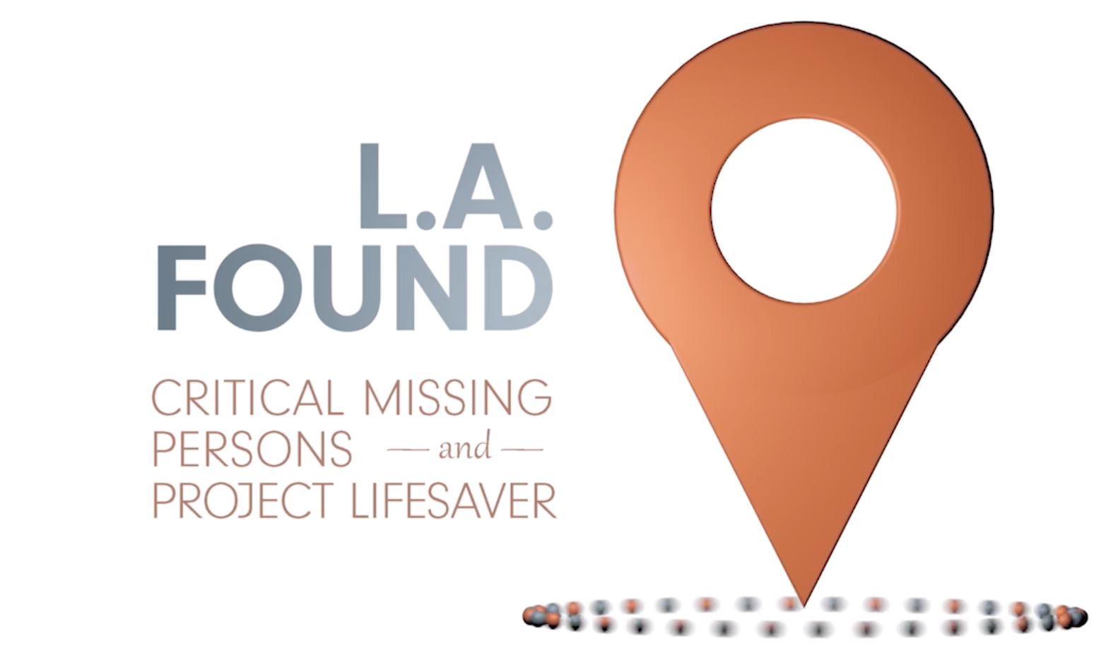
L.A. Found
Los Angeles County and the L.A. Found Initiative help caregivers of those living with Alzheimer’s, dementia, autism, or other cognitive impairments.
If the person you are caring for goes missing, we are here to help!
Sometimes, those living with Alzheimer’s, dementia, or autism go missing. Los Angeles County has partnered with Project Lifesaver and the Sheriff’s Department to help find these loved ones. Project Lifesaver provides a voluntary system of free trackable bracelets for at-risk individuals. When an individual wearing a bracelet goes missing, the LASD deploys a specially equipped team to assist with search and rescue by tracking the device.

Slide 12

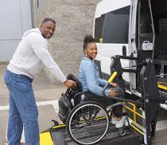

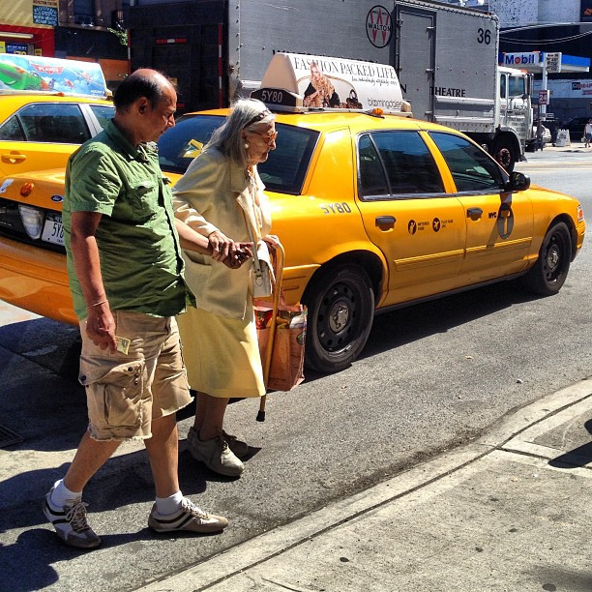
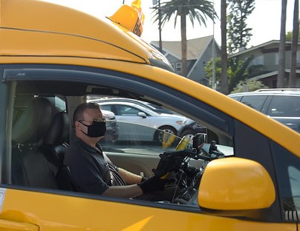
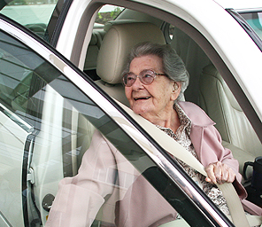
New Freedom Transportation
New Freedom Transportation Programs provide transportation throughout the Los Angeles County region to adults 65 years and older and adults with disabilities.
…Keeping YOU on the Move!
Volunteer Driver Mileage Reimbursement (VDMR)
VDMR is a client-centered transportation program that gives participants the opportunity to select one or more Volunteer Drivers for their transportation needs. Volunteer Drivers can be selected from a wide range of individuals including family, friends, caregivers, or neighbors.
New Freedom Transportation
510 S. Vermont Ave., Floor 11
Los Angeles, CA 90020
(888) 863-7411
Email: newfreedom@ad.lacounty.gov
Website: https://newfreedom.lacounty.gov
Door Assistance Transportation Program (DATP)
DATP is for clients with significant mobility limitations, an escort driver helps clients through the door(s) of their residence or destination(s) and may provide assistance with belongings.
Taxicab Services Program (TSP)
TSP services are like traditional taxicab services; however, for a seamless customer service experience, clients are issued a pre-loaded swipe card with a monthly transportation allowance.
12

Slide 13

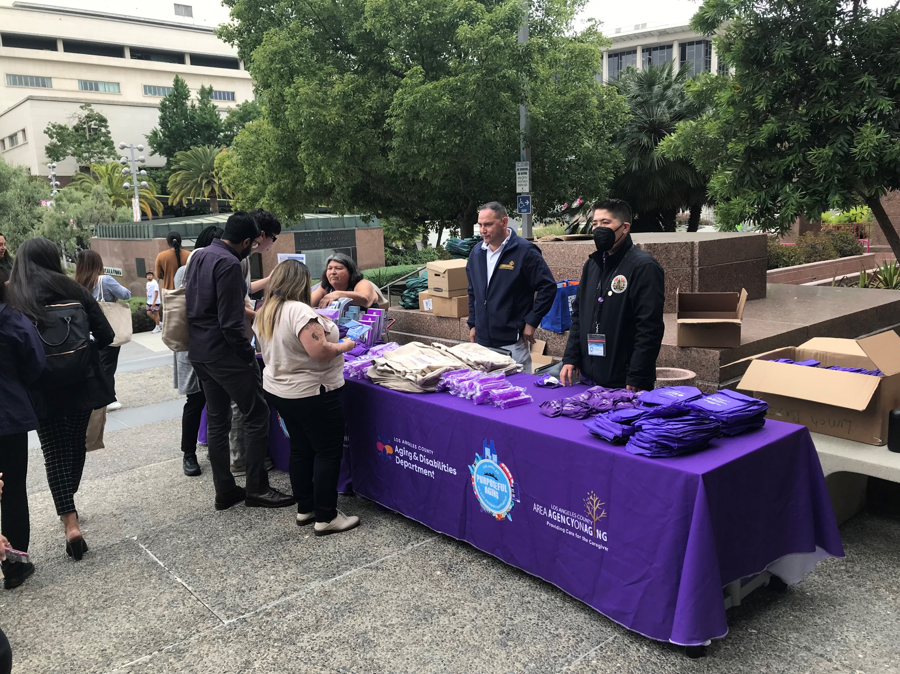
Information & Assistance (I & A)
The Aging & Disabilities Department Information & Assistance (I & A) Unit provides the following services:
  Provide resources/referrals by phone and e-mail to members of the public about community services available to older adults, people with disabilities, caregivers, and others.
  Respond to requests from Los Angeles County Board of Supervisors to assist constituents who have contacted them regarding services available to the community.
  Represent department at outreach events throughout Los Angeles County, raising public awareness of available services and older/dependent adult abuse in general.

Slide 14
COMMISSIONS

Slide 15

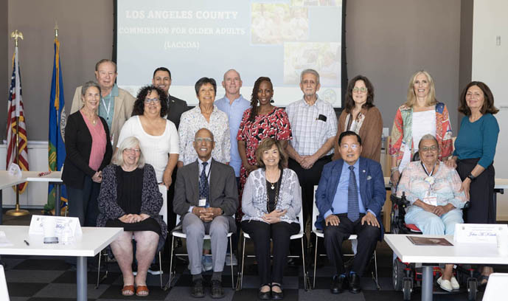
Los Angeles County Commission for Older Adults (LACCOA)
LACCOA advocates and provides advice regarding the needs and welfare of older adults (age 60+) in LA County.
Recommendations are given to the Board of Supervisors, the LA County Aging & Disabilities Department (AD), and other entities that provide services to older adults regarding their health, well-being, and rights.
LACCOA also serves as the advisory council to the LA County Area Agency on Aging (AAA) as mandated under the Older Americans Act.

Slide 16

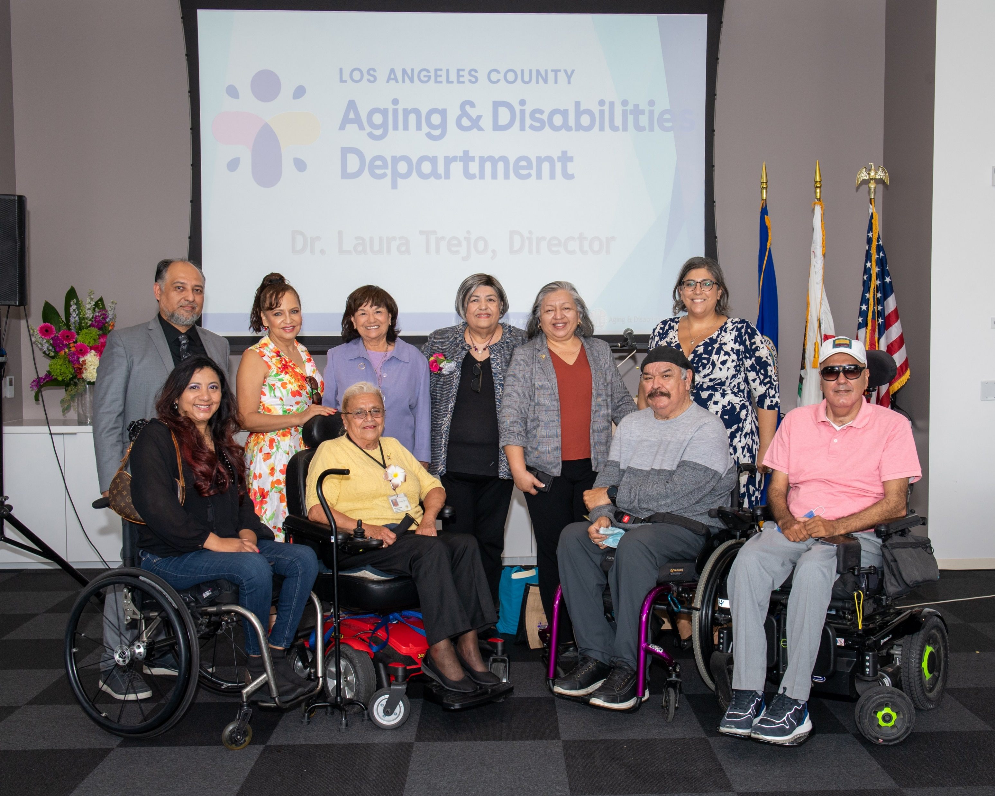
Los Angeles County Commission on Disabilities (LACCOD)
LACCOD advises the Board of Supervisors on a range of issues affecting the lives of people with disabilities, taking action to achieve a barrier-free County where people with disabilities have equal access to programs and services.
LACCOD focuses on issues of employment, education, diversity, health, housing, transportation, access, and recreation.
LACCOD also monitors the quality of municipal services, evaluates policy, and recommends improvements and other changes to existing laws.

Slide 17



Slide 18
