Slide 1
Fire Hazard Severity Zone Map Update Consideration
June 17, 2025

Slide 2
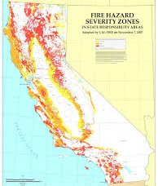
FHSZ Background
Developed by California Department of Forestry & Fire Protection Fire (Cal Fire)
Purpose: Identify locations with wildfire hazards to help communities implement mitigation efforts to reduce risk.
Notes:
ØFHSZ developed in 1985 for State Responsibility Areas
ØExpanded in 1995 to include Local Responsibility Areas
ØPeriodically Updated – last City update was 2008

Slide 3
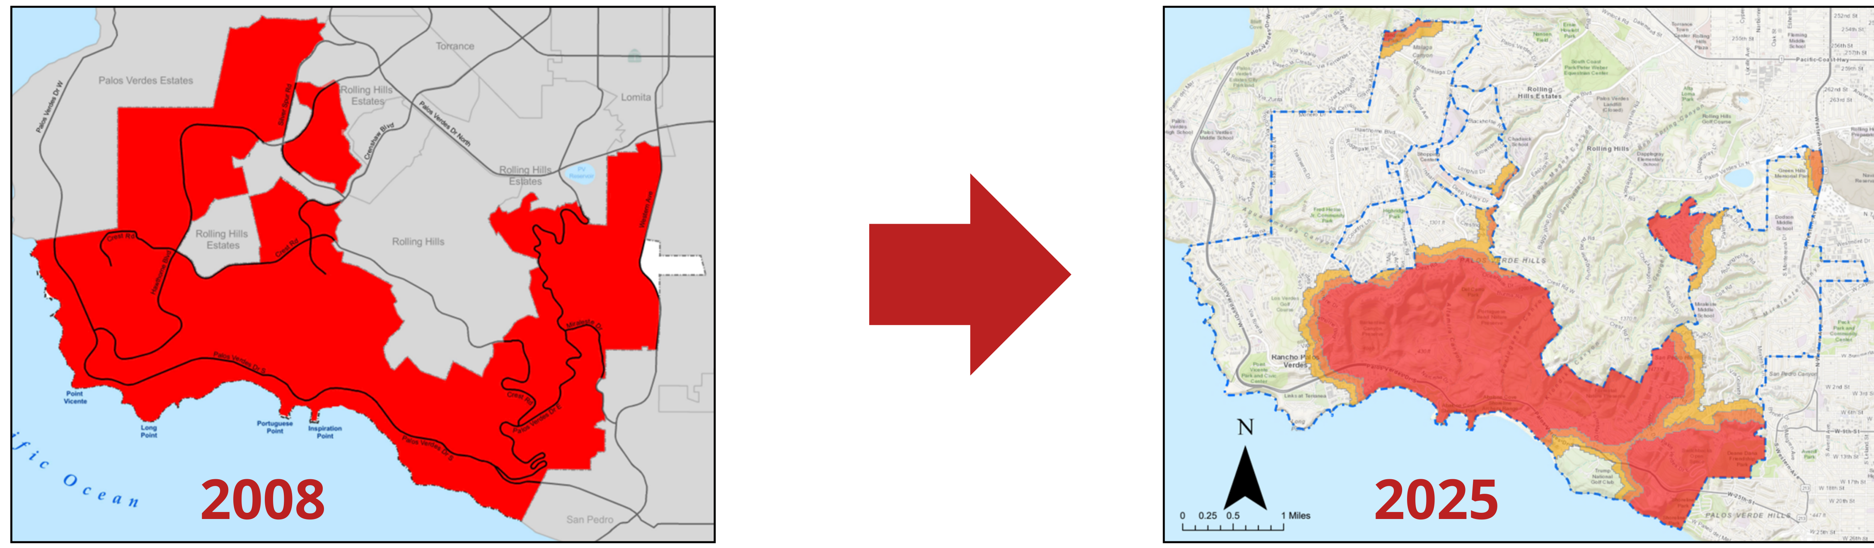
2025 Map
2025 Map Update
2025 Updated FHSZ map released on March 24, 2025. Changes include:
The addition of the “High” and “Moderate” zones
Substantial reduction of “Very High” designation on the Peninsula
Notes:
Incorporates new methodology:
Climate Data from 2003-2018
New considerations such as ember cast, temperature, humidity, wind speed over a 50-year period
Burn probability and expected fire behavior under the most extreme conditions
TONIGHT, We are asking the City Council to consider approving these updated maps. The alternative is to request any zones to be increased, those increased to VERY HIGH need substantial evidence to justify the increase, such as new climate data or fire history. However, zone designations cannot be reduced in severity.

Slide 4
2025 FHSZ Map Impacts
Title 8 Modifications: To include new zone classifications
Defensible Space Inspections and Enforcement: Only for “Very High” FHSZ
Hazard Disclosure: Those with no FHSZ designation no longer need hazard disclosure
City Plan Incorporation: Mult-Jurisdictional Hazard Mitigation Plan, City General Plan Safety Element, & Natural Communities Conservation Plan/Habitat Conservation Plan
Other potential impacts: Projects, grants, insurance, and building codes
Changes do not take effect until January 1, 2026

Slide 5
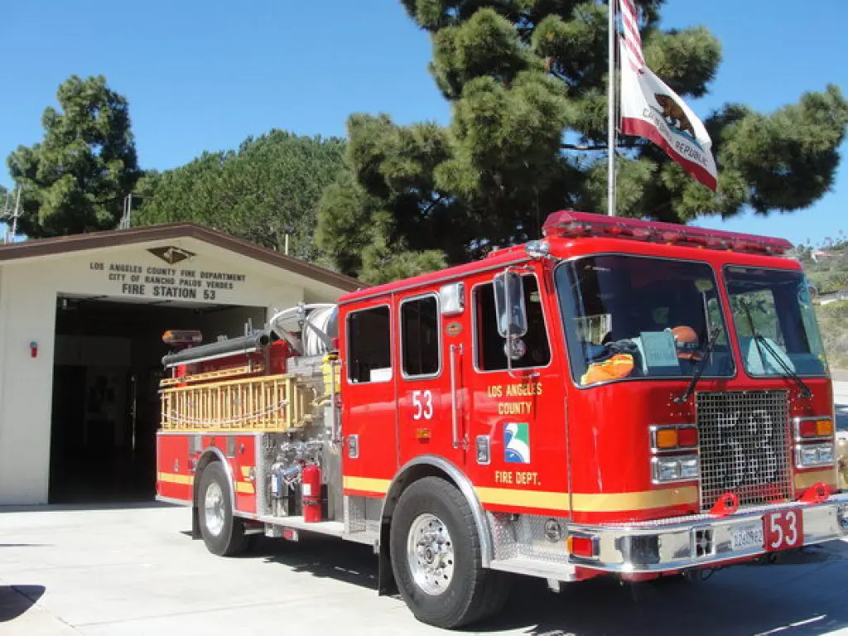
2025 FHSZ Update: Areas NOT Impacted
Wildfire Prevention Actions During Fire Weather
Firefighter Readiness
Fire Risk and Responsibilities
City Wildfire Mitigation Efforts

Slide 6
Recommendations
Consider the proposed 2025 Updated Fire Hazard Severity Zone Map
Introduce ordinance to accept the Updated 2025 Map and amend Section 8.08.060 (Very High Fire Hazard Severity Zone Map) of Title 8 of the Rancho Palos Verdes Municipal Code.
Notes:
If approved to introduce tonight’s ordinance, it will return for a second reading on July 1. Afterwards, staff will submit the map to Cal OES by no later than July 31 to finalize this process. The maps will be effective starting Jan. 1, 2026.

