Slide 1
27501 Western ave
Item No. 3
Conditional Use Permit Revision
(Case No. ZON2014-00182)
Applicant: John Resich
Property Owner: Green Hills Memorial Park

Slide 2
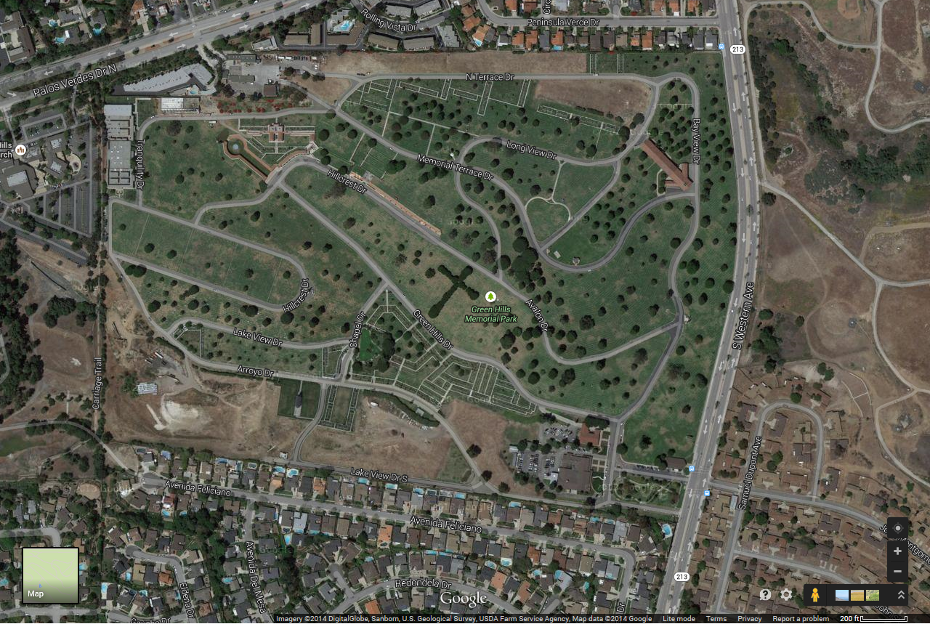
27501 Western (green hills memorial park)

Slide 3
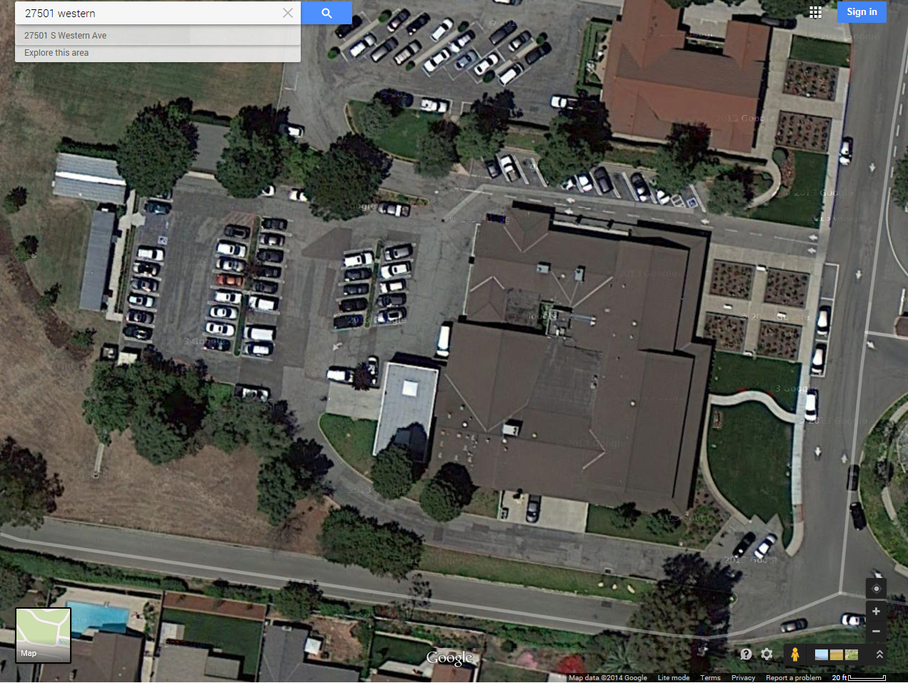
27501 Western (existing administrative building site – 69 Parking)

Slide 4
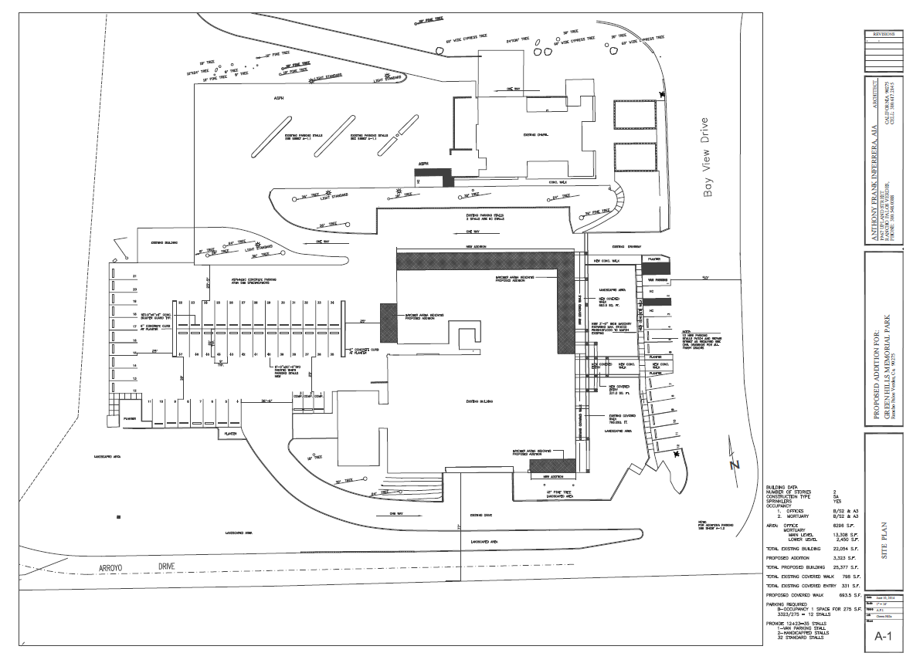
27501 Western (proposed administrative building site – 92 parking)

Slide 5
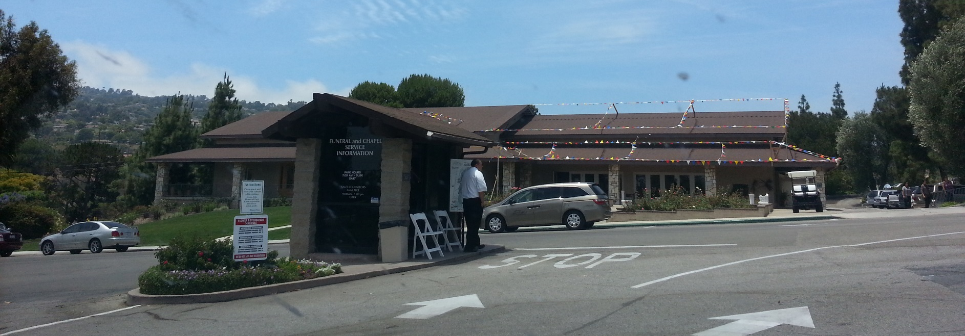
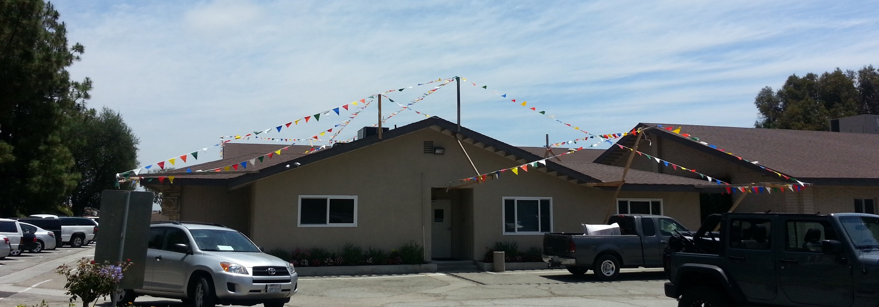
27501 Western (photos of front and rear façades)

