Slide 1
Trails Network Plan Update – Section 5
Public Workshop No. 6
Date: 5/4/2016

Slide 2
Background
Bikeway Plan adopted by City Council on March 4, 1975
General Plan adopted by City Council on June 26, 1975
Trail Standards Study adopted by City Council on June 15, 1982
Trails Network Plan adopted by City Council on November 27, 1984
Conceptual Trails Plan (CTP) and Conceptual Bikeways Plan (CBP) adopted by the City Council on January 22, 1990.
CTP was updated on December 6, 1991 and September 7, 1993
CBP was updated on October 15, 1996
2004 Open Space Task Force Recommendations
Preserve Trails Plan (PTP) adopted by the City Council on April 29, 2008
PTP amended by the City Council on October 2, 2012

Slide 3
Conceptual Trails Plan- Section 5
“A”- Palos Verdes Loop Trail
“B”- Top-Of-The-Hill Trail System
“C”- Palos Verdes Drive Trail
“D”- Coastal Bluff Trail System
“E”- Coastal Access Trails
“F”- Crest Road Trail System
“G”- Collector/Radial Trails
“H”- Top-Of-The-Hill Trail System-Loop Trail Connectors
“J”- Collector/Radial Trails
“K”- Portuguese Bend Residential Community Trail System
“L”- Forrestal Quarry System

Slide 4
Conceptual Trails Plan- 6 Trail Categories
Category 1 – Existing, dedicated trails which meet trail standards
Category 2 – Proposed trails which cross undeveloped privately-owned property that is zoned as being developable
Category 3 – Proposed trails which are located on existing easements, City property, or street right-of-ways and which require improvements
Category 4 – Proposed trails which cross privately-owned land designated as Open Space or Open Space Hazard, or owned by public utility or agency. These trails require the acquisition of easements
Category 5 – Proposed trails crossing privately-owned land which would primarily benefit neighborhood residents
Category 6 – Proposed trails which have special circumstances, considerations, or constraints

Slide 5
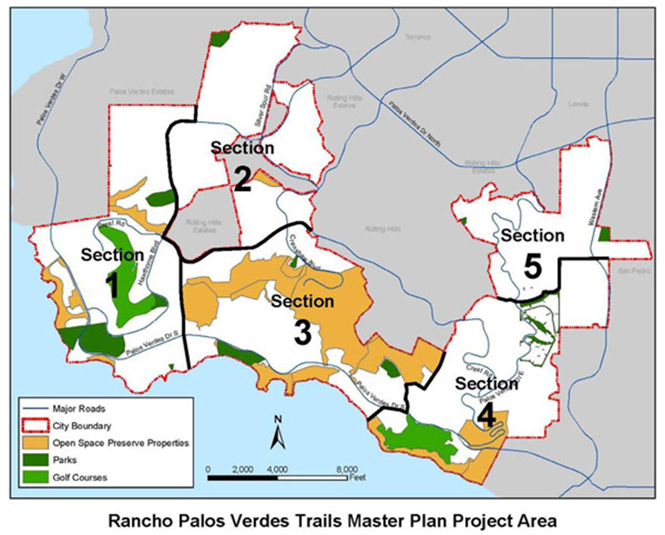
Conceptual Trails Plan- 5 Trail Sections

Slide 6
Trails Network Plan- Update Tasks
Incorporate the following to the Trails Network Plan:
Approved Preserve Trails Plan
Approved Ocean Front Estates Trails
Approved Terranea Resort Trails
Approved Trump National Trails
Approved California Coastal Trail
Additionally, assess the remaining conceptual trails described in the CTP for connectivity and viability purposes.

Slide 7
Conceptual Trails Plan- Section 5

Slide 8
Draft Section 5
Trails Plan Update Recommendations:
Trails to be Removed (Green)
Currently Existing Trails & Recorded Easements (Yellow)
Trails determined to be Conceptual (Orange)
Proposed Trails (Pink)

Slide 9
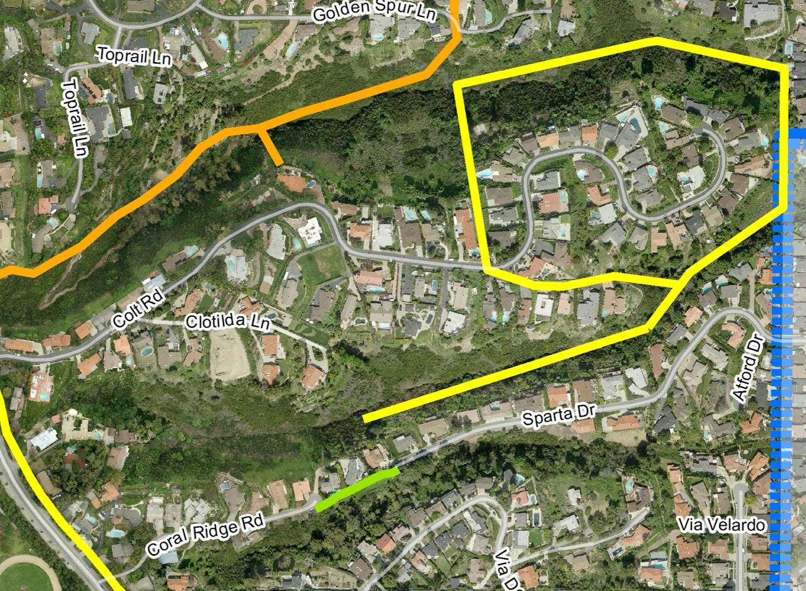
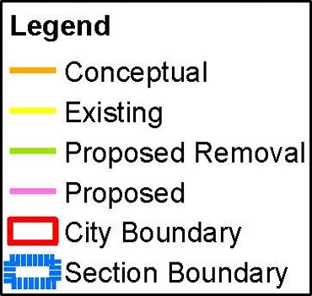
J1: Colt Trail – Easement Unimproved (Existing)
J2
J1
K3

Slide 10
J2: Saddle Trail – Easement Unimproved (Existing)
J2
J1
K3

Slide 11
K3: Sparta Neighborhood Access Link (Removal)
J2
J1
K3

Slide 12
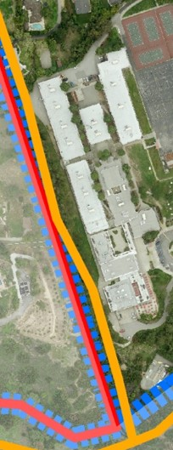
A21: High School Segment (Conceptual)
A21

Slide 13
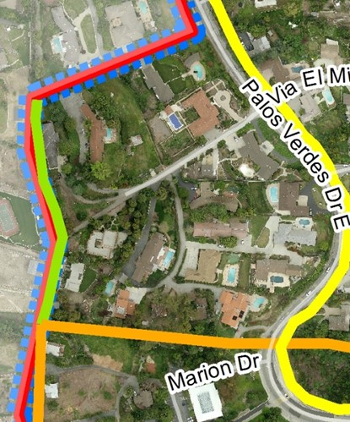
A22: Library Segment (Conceptual)
G2
A22
A21

Slide 14
G2: Old Wiley Trail (Removal)
G2
A22
A21

Slide 15
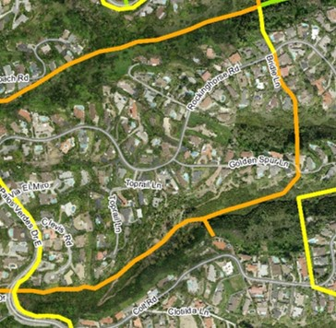
A23: Clevis Segment (Conceptual)
A26
A25
A24
J3
A23

Slide 16
A24: English Segment (Conceptual)
A26
A25
A24
J3
A23

Slide 17
A25: Goldenspur Segment (Conceptual)
A26
A25
A24
J3
A23

Slide 18
A26: Dodson Canyon Segment –Unimproved (Existing)
A26
A25
A24
J3
A23

Slide 19
J3: Louise Trail (Conceptual)
A26
A25
A24
J3
A23

Slide 20
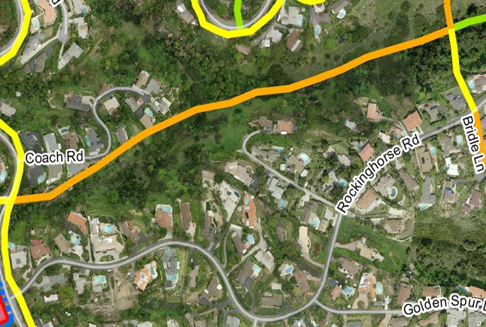
H1: Upper Dodson Canyon Trail (Conceptual)
H1

Slide 21
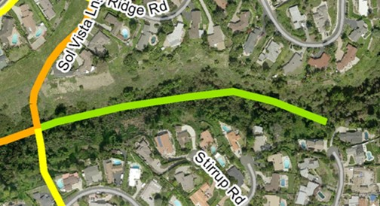
A27: Sol Vista Segment (Conceptual)
A27
H2
A26

Slide 22
H2: Lower Dodson Canyon Trail (Removal)
A27
H2
A26

Slide 23
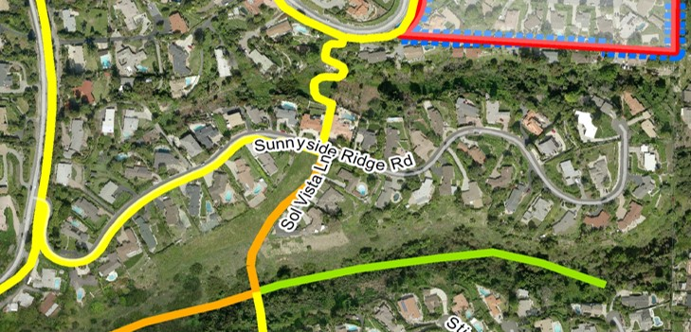
A28: Sunnyside Segment (Existing)
A28
F8
A27

Slide 24
F8: Sunnyside Ridge Road Trail (Existing)
A28
F8
A27

Slide 25
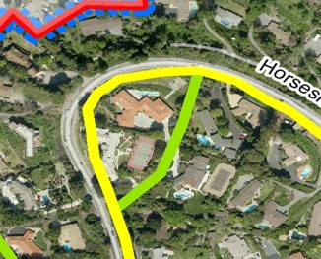
C18: Upper Palos Verdes Drive East Segment (Existing)
C18
K1

Slide 26
K1: Stonegate Cutacross (Removal)
C18
K1

Slide 27
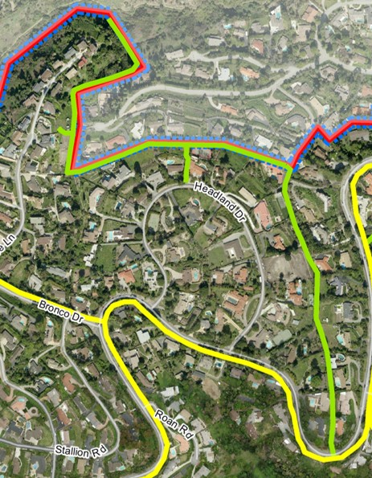
F4: Cayuse Canyon Trail (Removal)
F4
F5
F7
F6

Slide 28
F5: Cayuse Neighborhood Access Trail (Removal)
F4
F5
F7
F6

Slide 29
F6: Redhead Trail (Removal)
F4
F5
F7
F6

Slide 30
F7: Headland Neighborhood Access Trail(Removal)
F4
F5
F7
F6

Slide 31
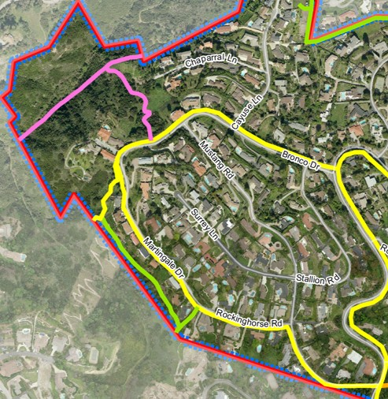
F1: The Gap Trail (Proposed)
F3
F1
F2
F9
F10
G3
F9
G1

Slide 32
F2: Bronco Trail (Proposed)
F3
F1
F2
F9
F10
G3
F9
G1

Slide 33
F3: Georgette Canyon Trail (Proposed)
F3
F1
F2
F9
F10
G3
F9
G1

Slide 34
F9: Bronco Roadside Loop Trail (Existing)
F3
F1
F2
F9
F10
G3
F9
G1

Slide 35
F10: Martingale Trail(Existing)
F3
F1
F2
F9
F10
G3
F9
G1

Slide 36
G1: Paper Trail (Removal)
F3
F1
F2
F9
F10
G3
F9
G1

Slide 37
G3: Hunter Trail (Removal)
F3
F1
F2
F9
F10
G3
F9
G1

Slide 38
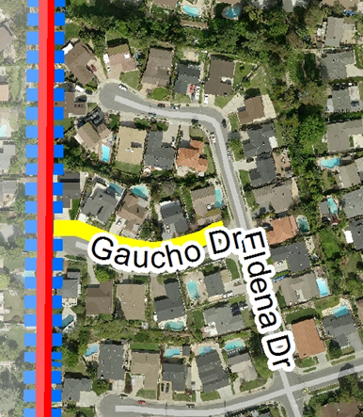
K2: The Gaucho Cutacross (Existing)
K2

Slide 39
Updated Tentative Timeline
Workshop No. 1 (Kick-off) – June 25, 2014
Workshop No. 2 (Section 1 ) – October 29, 2014
Workshop No. 3 (Section 2) – April 2015
Workshop No. 4 (Section 3) – October 2015
Workshop No. 5 (Section 4) – February 2016
Workshop No. 6 (Section 5) – May 2016
Workshop No. 7 (Draft Document) – Summer 2016
Planning Commission Meeting - Fall 2016
City Council Meeting – Winter 2016

Slide 40
Public Outreach
City website (Trails Network Plan)
List-serve subscribers
Quarterly Newsletter
Peninsula News

