Slide 1
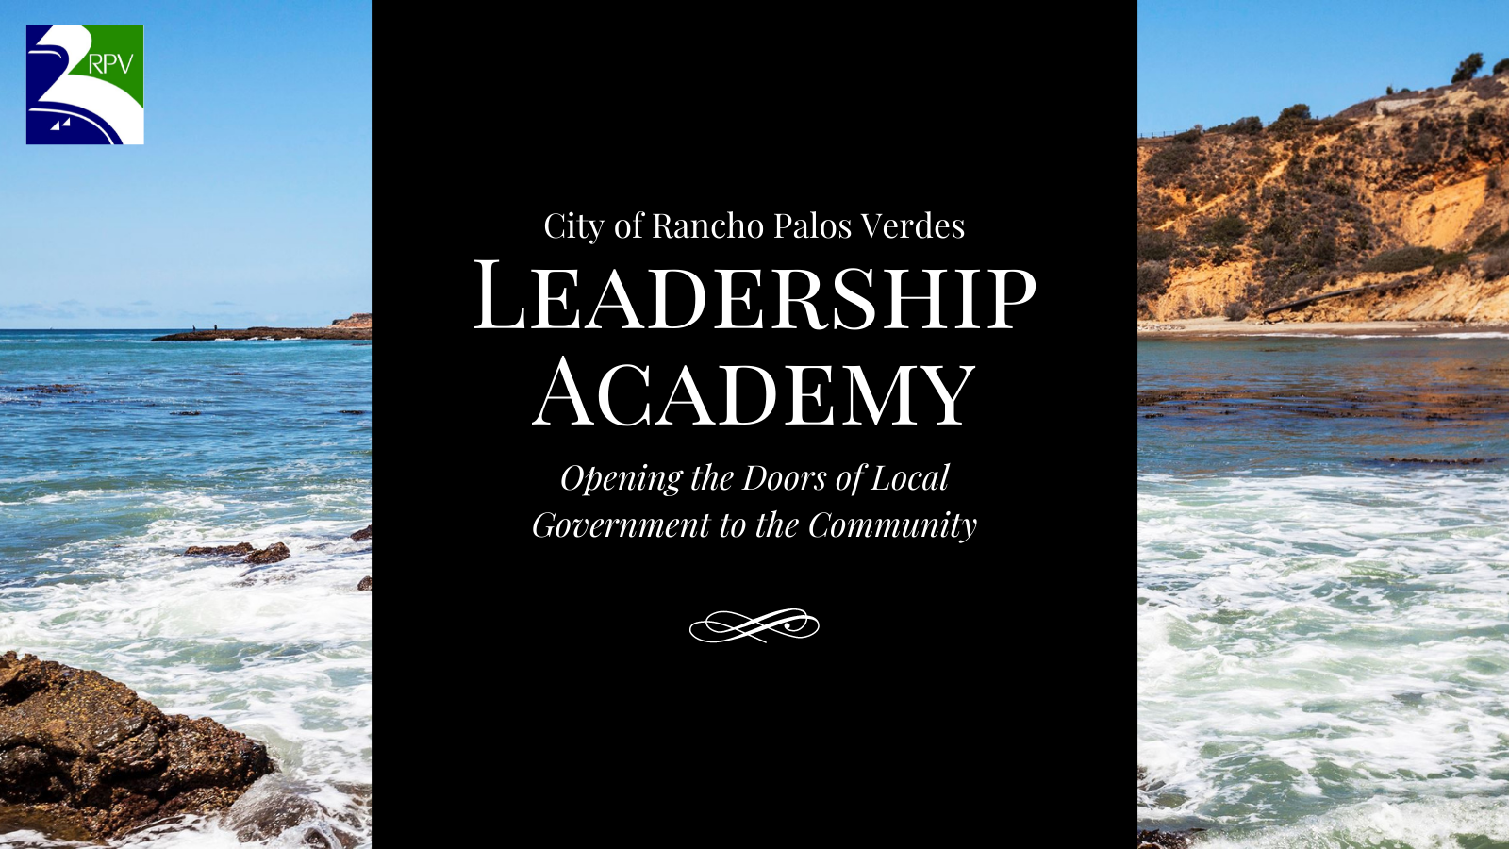
Fall 2021

Slide 2
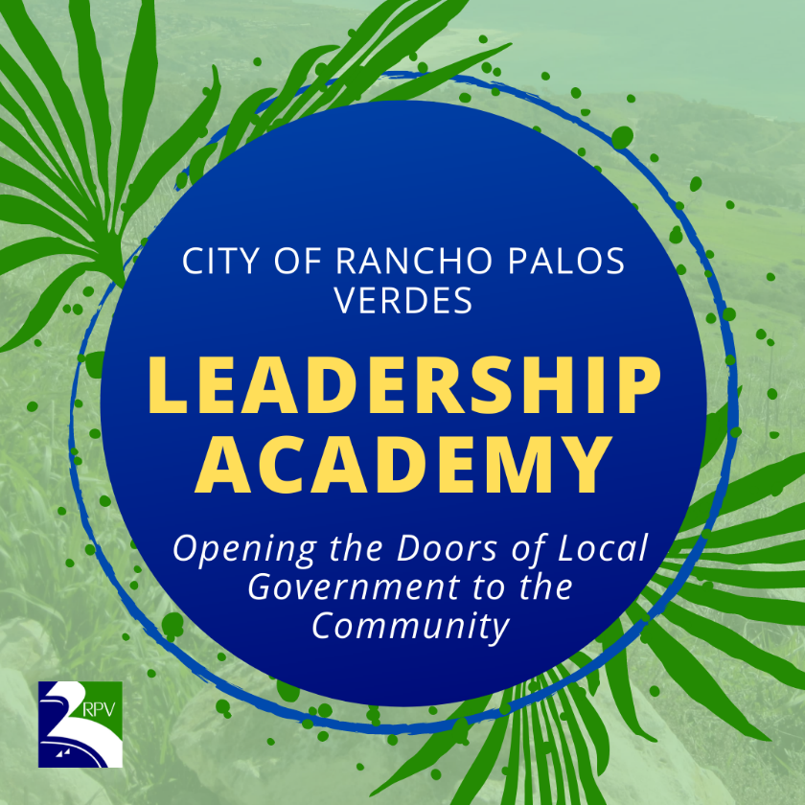

Agenda
Finance Department and Public Works Department Presentation
Department Organizational Structure & Overview
Key Areas of Focus
Advisory Committee by Department
Breakout Session
Lessons Learned – Wrap up
Rancho palos verdes

Slide 3
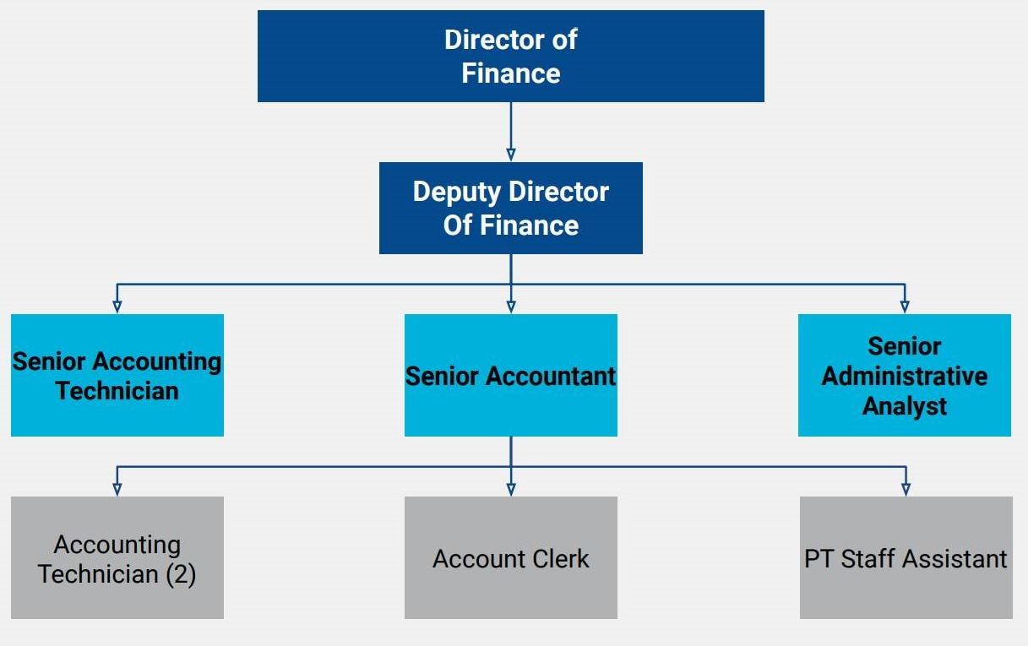
Finance Department Organizational Chart
Rancho palos verdes
Notes:
The Finance Department is the gate keeper of the City assets. We manage and monitor both the financial and the human resources for the City.
We operate with 8 FT and 1 PT staff, myself included.
The department is divided into two major functions: operating and compliance. More recently we added a third component, special projects.

Slide 4
Finance Department – Annual Operations
Operational and Capital Budgeting
Long-term Financial Planning
Treasury
General Accounting
Administration
Purchasing
Payroll
Rancho palos verdes
Notes:
Under operation we have:
Operational and Capital Budget
This is the roadmap or framework of our annual operation. It tells us how expenditures will be paid and where to record our revenues. This is a year-round process and I’ll cover the budget cycle and process in more details in the next slide.
Long-term financial planning was the 5-year financial model which was extended to 10-year.
Begins in January of each year
Update the prior year actuals
Upload the adopted budget
Update the assumptions
Analyze and review changes to the mode
Administration
Fiscal policy
Enforce, monitor, review, and update fiscal policy as needed
A couple of the more recent updates are the Procurement Policy, the City Council Reserve Policy, and most recently we introduced the Pension Guideline to address the raising pension cost.
System administration
Manages the financial system
Creating/managing approval workflow
Creating business process to align with the department and city’s operation
System upgrade
Review and approve new users
Staff liaison to the Finance Advisory Committee
Manage the business license and false alarm program
Treasury
Banking and investment
Manage and monitor the City’s cash position
Investment strategy is in line with the City’s investment policy
Manage the daily cash balance of the operating account
Manage the authorize signer for all city’s accounts
General Ledger
Accounting
Chart of accounts
Month end closing – budget reconciliation, upload financial to OpenGov, correction/closing entries
Year-end closing
Bank reconciliation
Accounts receivable
Daily deposits
Trust deposits
Reimbursements
Accounts payable
Cal-card
Travel & conference
Petty cash
Vendor payments (professional services, utility bills, rent & leases)
Cashiering
Purchasing
Vendor maintenance
Purchase order maintenance
Enforcing the procurement policy
Payroll
Bi-weekly payroll process
Payroll tax submission
Payroll vendor payment

Slide 5
Finance Department – Budget Cycle
Planning
Workshops
Financial Review
Adoption
Implement-ation
Rancho palos verdes
Notes:
The budget cycle is a 24 months cycles. But the bulk of the work is in the first 6-8 months.
So for FY 2021-22
The planning stage started in January 2021. The process includes
Meeting with the CM and departments to discussion the city’s current financial positions and projections for the upcoming fiscal year.
Then we open the system for the departments to input the budget requests for non-personnel
Finance prepare personnel projections and revenues
Workshops - 3 workshops: City Council Goals, General Fund, and CIP
Based on the City Council’s direction, we would then prepare the preliminary budget
Financial review – this used to be a 5-year financial model but we recently expanded it to 10 year
Input the preliminary budget and assumptions to projects the City’s financial positions
Report any financial concerns in the preliminary budget report
Update the preliminary budget based on the City Council direction and prepare the budget adoption document
Adoption – budget hearing is open the first meeting in June and budget adoption in the second meeting.
By the time budget is adopted we would have written about 6 staff reports on budget, not including the report we prepare for the Finance Advisory Committee.
Implementation - once budget is adopted in June:
Enter the budget in the financial system and open up the new FY
Prepare the budget in brief, a quick summary of the City’s adopted budget. I have included a copy in your package.
Prepare the budget book, the online version and a hard copy.
The monitoring & reporting of the budget goes from July 1, 2021 thru December 2022 because we need to monitor and report until FY 2021-22 closes. So there is always an overlapping of budget for us. Because FY 2022-23 budget cycle will begins in January 2022 but we are still monitoring and working with FY 2021-22 budget.
Review and post budget transfer requests
Enter and post additional budget appropriation
Prepare monthly financial and upload to OpenGov
Prepare quarterly and annual reports

Slide 6
Finance Department – Compliance & Regulatory Reporting
County, State, and Federal Government Fiscal Requirements
Annual Audits
Tax Reporting
State Controller Reporting
Internal Control
Grant Tracking
Rancho palos verdes
Notes:
The annual operation is about 75% of the activity in the department. The remaining 25% is in the compliance and reporting.
Annual audits
External audits
Metro audits – Metro funds such as Prop A, Prop C, and Gas Tax
Street audits
Single audits – Spending of federal money of $750,000 or more in a fiscal year
AQMD audits – Air Quality Management District
Internal control
Segregation of duties
Fraud prevention
Tax reporting
Federal and state payroll tax (941, DE9, W2)
Quarterly Sales Tax
1099
State controller reporting
Grant tracking

Slide 7
Finance Department – Areas of Focus
Financing for Infrastructure Projects
Ladera Linda Park and Community Center Project
Portuguese Bend Landslide
American Rescue Plan Act
Compliance and reporting
Project status
Employee Retention and Succession Planning
Civic Center
Attract and retain employees
Offer personal and professional growth for all employees
Opportunities to promote high-performing employees
Annual audit
Rancho palos verdes
Notes:
The areas of focus or what I refer to as special projects. The department areas of focus come from the City Council goals/directives, assigned by the City Manager, or my vision/goal for the department. Last year, our focus was on the 10-year financial model, the City’s pension obligation, the financing options for the Ladera Linda project, upgrade of the financial system, and the new budget book. I’m proud to say that four of the five areas were accomplished before the end of the fiscal year. The budget book was 75% completed and the remaining 25% had to be done after the budget adoption. This year, our focus will be on the:
Financing for large infrastructure projects such as the Ladera Linda, Civic Center, and Portuguese Bend Landslide.
The City Council approved the financing options for the Ladera Linda project on May 18th but we are still working on the final stage of the financing so that’s the reason it is still on our radar for this year and it will probably continue until long after this project is completed.
American Rescue Plan Act, and
Employee Retention and Succession Planning
This conclude my presentation and now I’ll pass it on the director Awwad to share some insights on the Public Works Department.

Slide 8
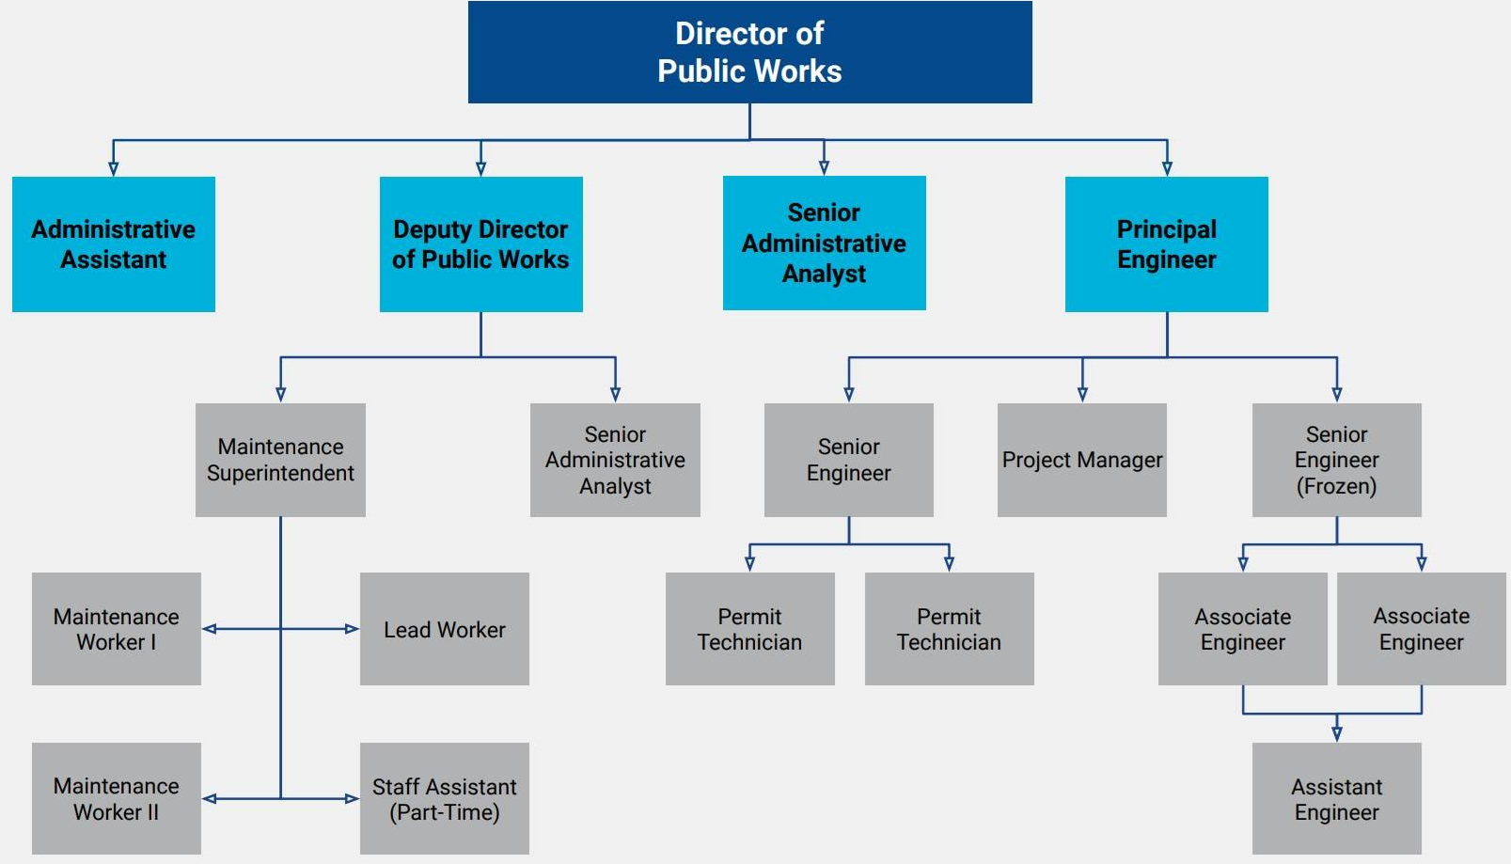
Public Works Department Organizational Chart
Rancho palos verdes

Slide 9
Public Works Department
Asset management of approximately 150 miles of public streets with associated curb and gutters, sidewalks, guardrails, and pavement markings;
Traffic engineering and operations including congestion mitigation, traffic calming, and management of approximately 16 traffic signals, 7,000 traffic signs, and 1,750 streets;
Transit coordination;
Permit parking program;
Stormwater program including the City’s drainage system and stormwater quality management programs;
Permitting and inspection in the public right-of for utility work including Small Wireless Facilities;
Asset management and operation of the sanitary sewer collection for the Abalone Cove Sanitary Sewer District comprised of 270 households;
Rancho palos verdes

Slide 10
Public Works Department
Coordination of utility services for gas, electricity, water, and sanitary sewer collection outside of the Abalone Cove Sanitary Sewer District;
Asset management of five city facilities and associated park maintenance;
Solid waste and recycling management for approximately 12,000 residential units as well as 250 commercial and multi-family units;
Landslide monitoring and remediation projects;
Fuel modification for approximately 300 acres of open space;
Public street landscaping and beautification;
Coastal bluff fence maintenance;
City vehicle fleet maintenance;
Environmental sustainability programs; and
Development and implementation of the City’s Capital Improvement Plan
Rancho palos verdes

Slide 11
Public Works Department – Current Projects
Rancho palos verdes

Slide 12
City Advisory Boards
Finance Advisory Committee
Seven members that meet via zoom on Thursdays at 7:00pm
Committee participates in the analysis of the city's financial future during its annual review of the 5-Year Financial Model prepared by staff.
Assists the City Council by reviewing other projects that may have a financial impact on the city.
These appointments are non-paying volunteer positions that require attendance at about six evening meetings annually. Appointments generally have terms of office ranging from two to four years.
To qualify for appointment, applicants must be a resident of the city of Rancho Palos Verdes.
Rancho palos verdes
Notes:
The committee meet on the third Thursday at 7 PM. Prior to COVID, we typically meet in the Community Room at City Hall but currently, all of our meetings are virtual.
The committee receive a report and discuss a wide range of the city’s financial position. From annual budget to long-term financial impacts.
The committee also received special assignments from the City Council such as financing options for large capital project and the city’s pension obligation.

Slide 13
City Advisory Boards
Traffic Safety Committee
Infrastructure Management Advisory Committee
Seven members that meet via zoom on the 3rd Monday of the month at 6:00pm
Prepare an annual work plan that includes reviewing each infrastructure category and reporting to the City Council and the community on the progress of projects, maintenance standards and performance, and the implementation of the Infrastructure Management Plan.
Focus on the city’s infrastructure needs and advise the City Council on capital improvement projects, maintenance issues and solutions.
Participate in the creation of the city’s first-ever Infrastructure Management Plan.
Five members that meet on the 4th Monday of every other month at 6:30pm
Serves as a public forum for traffic-related issues, including:
Placement of stop signs
Posted speed limits
Road modifications
Safety devices
Traffic signals
Rancho palos verdes

Slide 14

Break

Slide 15
Breakout Session
Scenario:
Rancho palos verdes

Slide 16
Fall 2021

